Slide 1
COMMUNITY SERVICES EVANGELISM

Slide 2
ISAIAH 58:6-9 (NKJV)
"Is this not the fast that I have chosen:
To loose the bonds of wickedness,
To undo the heavy burdens,
To let the oppressed go free,
And that you break every yoke?
Is it not to share your bread with the hungry
And that you bring to your house the poor who are cast out;
When you see the naked, that you cover him,
And not hide yourself from your own flesh?
Then your light shall break forth like the morning,

Slide 3
ISAIAH 58:6-9 (NKJV)
Your healing shall spring forth speedily,
And your righteousness shall go before you;
The glory of the LORD shall be your rear guard.
Then you shall call, and the LORD will answer;
You shall cry, and He will say, 'Here I am.'”

Slide 4
Five Basic Human Needs:
Physiological Needs
Need for Safety
Belonging and Love
Self-esteem
Drive for Self-Actualization
--Psychologist Abraham Maslow

Slide 5
Ministering to Human Needs
Unless people’s basic needs are supplied, they will not readily accept the preaching of the Gospel.
Christ understood this, and has left us a model for effective ministry.

Slide 6
Christ’s Method
Christ’s method alone will give true success in reaching the people. The Saviour mingled with men as one who desired their good. He showed His sympathy for them, ministered to their needs, and won their confidence. Then He bade them, ‘Follow Me’ (MH. p. 143).

Slide 7
Important Elements of Christ’s Method
Christ mingled with others as one desiring their good.
Christ sympathized with them.
Christ ministered to their needs.
Christ won their confidence.
Christ invited them to follow Him.
Christ promised to make them “fishers of men” (Matt. 4:19).

Slide 8
WELFARE MINISTRY, p. 29
“I have been instructed to refer our people to the fifty-eighth chapter of Isaiah. Read this chapter carefully and understand the kind of ministry that will bring life into the churches. The work of the gospel is to be carried by means of our liberality as well as by our labours. When you meet suffering souls who need help you should give it to them. In doing this you will be working on the lines of Christ’s ministry. The Master’s holy work was a benevolent work. Let our people everywhere be encouraged to have a part in it.”-- Manuscript 7, 1908.

Slide 9
Ways to minister to your Community
Visiting and praying for the sick
Have services of appreciation for professional groups
Distribute food to the needy
Arrange for homes and/or care for orphans and the aged
Conduct Health Clinics in communities
Make or mend garments for the needy
Make needed articles and scrapbooks for orphanages, old peoples’ homes, and hospitals.
Reading to the aged and the blind
Conduct classes in cooking, sewing, computer literacy and home nursing.
Conducting prison ministry.
Care for children and help burdened mothers.
Sympathize with and minister to the bereaved.

Slide 10
Ways to minister to your Community
Caring for widows.
Conduct literacy classes as well as classes for students doing external exams.
Cooperating with Red Cross and other disaster relief organizations.
Helping disadvantaged children to attend summer camp.
Helping to take care of the poor in the church.
Soliciting clothing, bedding and other needed supplies for the public.
Follow-up visiting after giving material aid.
Inviting the poor and the aged to Christmas dinners.
Growing vegetables and fruits for the Community Service Centre.
Sending get-well messages.
Teaching home management and care of children

Slide 11
Testimonies for the Church, vol. 9, p. 53
“Those who are truly converted will regard themselves as God’s almoners and will dispense, for the advancement of the work, the means He has placed in their hands. If Christ’s words were obeyed, there would be sufficient means in His treasury for the needs of His cause. He has entrusted to men and women an abundance of means for the carrying forward of His plan of mercy and benevolence. ”

Slide 12
Testimonies for the Church, vol. 9, p. 53
“He bids His stewards of means invest their money in the work of feeding the hungry, clothing the naked, and preaching the gospel to the poor. Perfection of character cannot possibly be attained without self-sacrifice.”

Slide 13
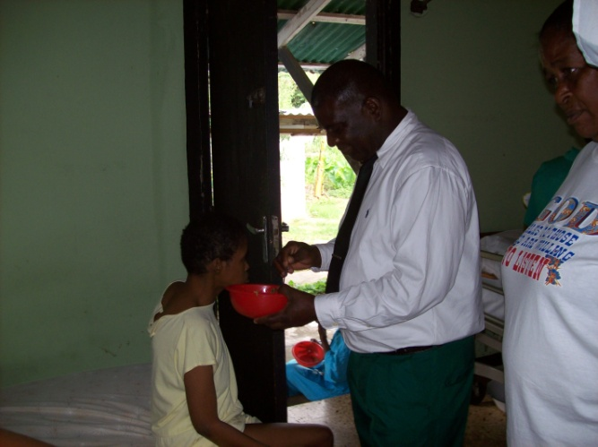
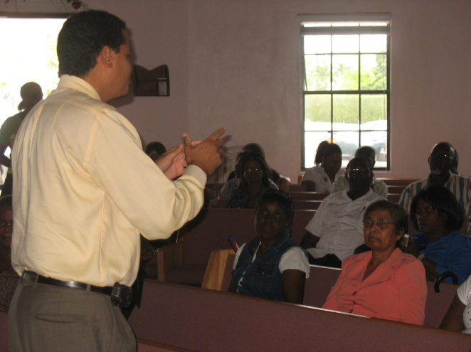
Community Services Evangelism
Community Services Evangelism should be the advance guard that prepares the hearts of men to receive the Word of God.
People should know we are Christians by our love.
Every Seventh-day Adventist Church should embark on at least one community project annually

Slide 14
Welfare Ministry, p. 168
A true Christian is the poor man’s friend. He deals with his perplexed and unfortunate brother as one would deal with a delicate, tender, sensitive plant. God wants His workers to move among the sick and suffering as messengers of His love and mercy. He is looking upon us, to see how we are treating one another, whether we are Christ-like in our dealing with all, high or low, rich or poor, free or bond. When you meet those who are careworn and oppressed, who know not which way to turn to find relief, put your hearts into the work of helping them…”

Slide 15
Welfare Ministry, p. 168
“…It is not God’s purpose that His children shall shut themselves up to themselves, by taking no interest in the welfare of those less fortunate than themselves. Remember that for them as well as for you Christ died. Conciliation and kindness will open the way for you to help them, to win their confidence, to inspire them with hope and courage.—Letter 30, 1887

Slide 16
Welfare Ministry, p. 70
My brethren and sisters, give your selves to the Lord for service. Allow no opportunity to pass unimproved. Visit those who live near you, and by sympathy and kindness try to reach their hearts. Visit the sick and suffering, and show a kind interest in them. If possible, do something to make them more comfortable. Through this means you can reach their hearts, and speak a word for Christ. Eternity alone will reveal how far reaching such a line of labor can be.—Review and Herald, Nov. 21, 1907.

Slide 17
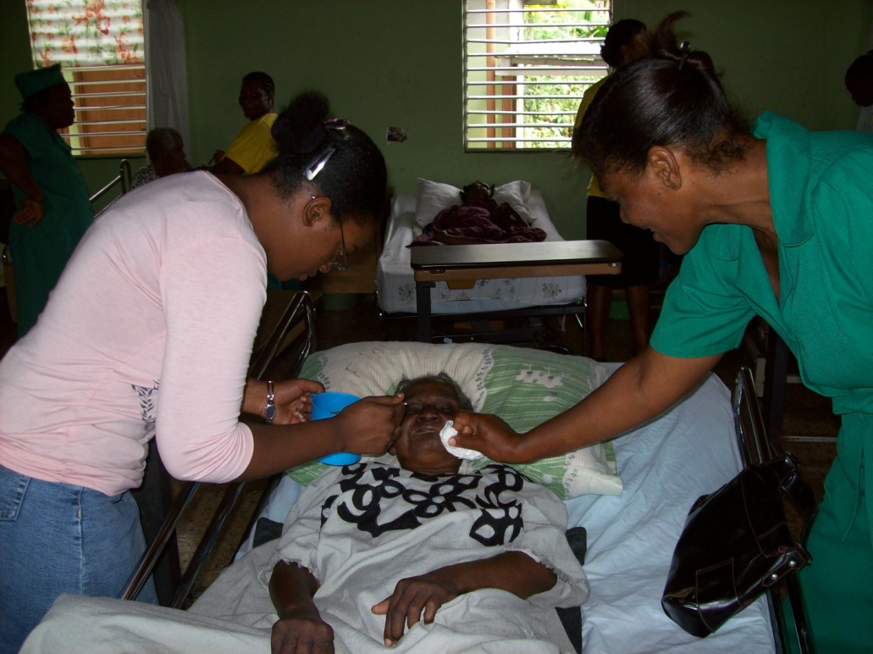
Community Services Evangelism
Matthew 5:16
Let your light so shine before men, that they may see your good works, and glorify your Father which is in heaven.

Slide 18
Community Services Evangelism
“If we would humble ourselves before God, and be kind and courteous and tender hearted and pitiful, there would be one hundred conversions to the truth where now there is only one.” Testimonies for the Church, vol. 9, p. 189

Slide 19
Bibliography
Desire of Ages
Christian service
NKJV Bible
Small Groups: Divine Plan for the Church
Thoughts from the mount of blessing
Manuscript 7
Review & herald
Testimonies for the church volume 9
Letter 30
Welfare ministry
VISITATION by Inter American Division, 2002

