Slide 1
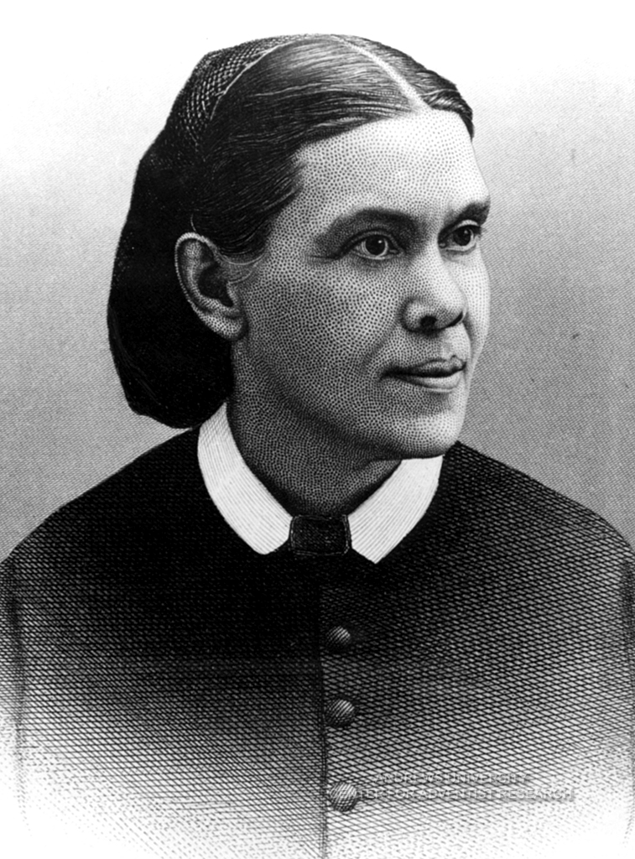
GSEM 534
Lecture #6
A Hermeneutical Method for the Writings of Ellen White
Part I: Who Needs It?

Slide 2
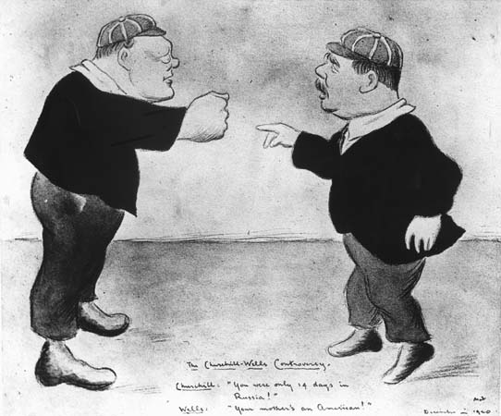
A Practical Reason for the Importance of Hermeneutics
Most controversies over the use of the Ellen G. White writings are at least ostensibly related to issues of interpretation.

Slide 3
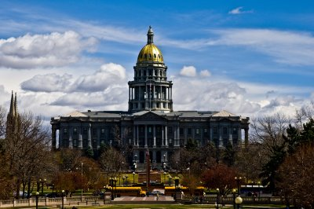
A Contemporary Example
Denver County Courthouse, early 1999
Judge Claudia Jordan scribbled a message to a clerk.

Slide 4
What the Clerk Read:
Blind on the right side.
May be falling.
Please call someone.

Slide 5
The Clerk’s Interpretation
“Blind on the right side,” plus fear of falling
could be symptoms of a stroke.
So the clerk rushed out and called paramedics.
When the paramedics came running into the courtroom, they found . . .

Slide 6
What Judge Jordan Meant
[The window] blind on the right side may be falling.
Please call someone [to fix the blind].

Slide 7
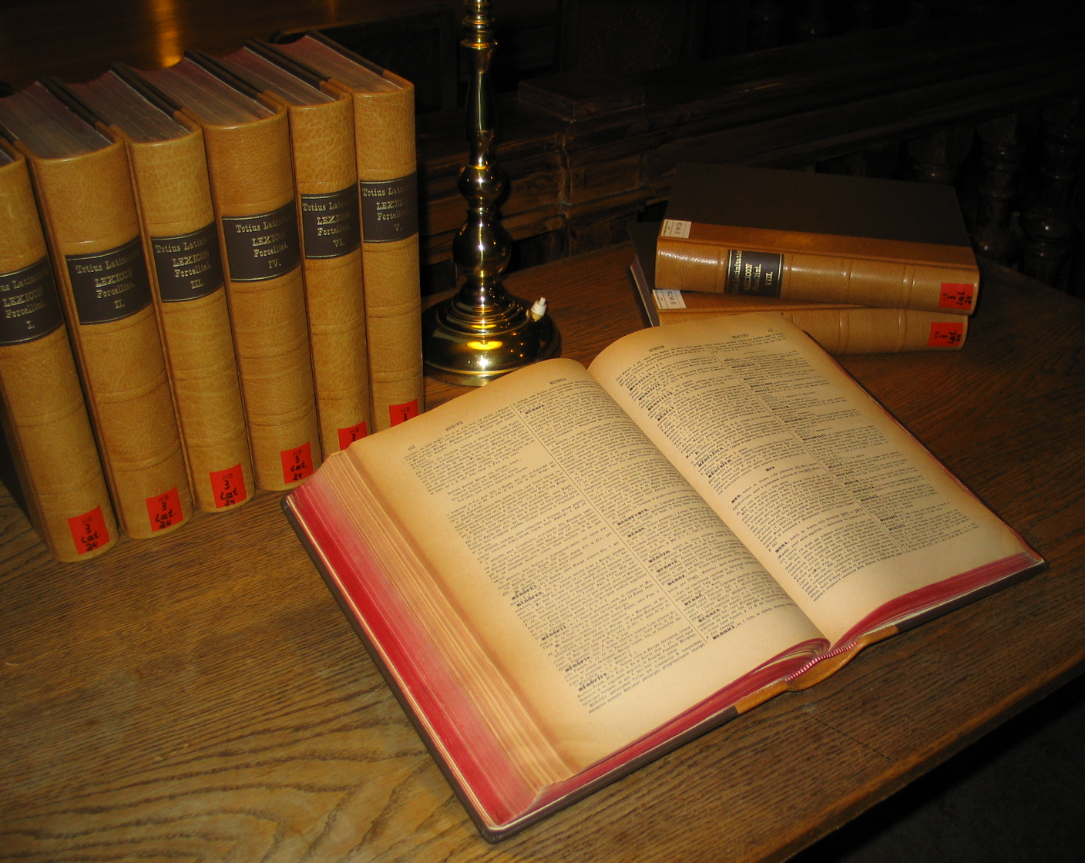
Definition of Hermeneutics
“The study of the methodological principles of interpretation and explanation.”
-Merriam-Webster’s Third New International Dictionary.

Slide 8
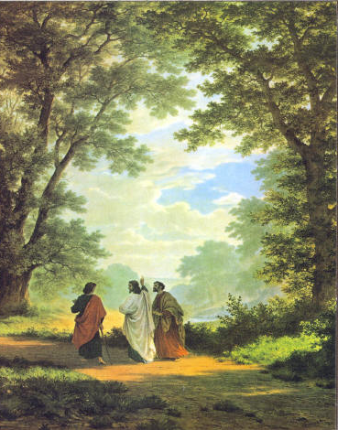
The Biblical Use of the Term Hermeneutics
Luke 24:27
“And beginning at Moses and all the Prophets, He expounded [di-hermeneuo] to them in all the Scriptures the things concerning Himself.”
Road to Emmaus

Slide 9
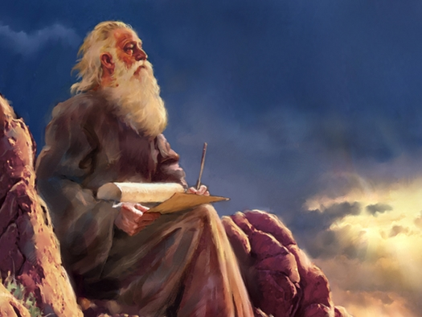
Chief Concerns of Hermeneutics
“What did the prophet mean by what the prophet said?”
What does the prophet’s message mean today?”

Slide 10
Why Some Think There Is No Need For Hermeneutics
They say, “Take it just as it reads, in plain English. You don’t need hermeneutical rules to interpret inspired writings.”

Slide 11
Why Some Think There Is No Need For Hermeneutics
Ellen White did say, “Take the word of God just as it reads” (UL 144)
but she meant the plain meaning of the totality of Scripture on a topic, not necessarily the apparent meaning of an isolated text.

Slide 12
The “plain meaning” is not always equally “plain” to all believers
Does the commandment, “Thou shalt not kill,” forbid killing insects?
Some Adventists in 1901 thought so, but EGW said this was “not according to sound reasoning” (Ms 70, 1901, in 3 SM 329; cf. CW 47).

Slide 13
Dangers in a Misuse of Hermeneutics
Danger 1: Rules of interpretation can be misused to water down the inspired message:
“Thus you have made the commandment of God of no effect by your tradition” (Matthew 15:4-6).

Slide 14
Testimonies 5: 691
“And now, brethren, I entreat you not to interpose between me and the people, and turn away the light which God would have come to them. Do not by your criticisms take out all the force, all the point and power, from the Testimonies. Do not feel that you can dissect them to suit your own ideas, claiming that God has given you ability to discern what is light from heaven and what is the expression of mere human wisdom.

Slide 15
Testimonies 5: 691
“If the Testimonies speak not according to the word of God, reject them. Christ and Belial cannot be united. For Christ's sake do not confuse the minds of the people with human sophistry and skepticism, and make of none effect the work that the Lord would do.”

Slide 16
Interpretational Key
“The testimonies themselves will be the key that will explain the messages given, as Scripture is explained by Scripture.”
(1SM 42)

Slide 17
Four Reasons Why We Need A Clear Hermeneutical Method
1. The Existence of Misinterpretation: “Men take the testimonies the Lord has given. . . picking out a sentence here and there, taking it from its proper connection, and applying it according to their idea. Thus poor souls become bewildered, when could they read in order all that has been given, they would see the true application, and would not become confused. Much that purports to be a message from Sister White, serves the purpose of misrepresenting Sister White” (1 SM 44).

Slide 18
2. Distance:
The greater our chronological, historical, theological, and linguistic distance from the original context in which she wrote, the more we need a hermeneutical method that pays close attention to all these areas.

Slide 19
3. Truth:
Our need to know the will of God —
as accurately as possible—demands a
Bible- and Spirit-of-Prophecy-based
hermeneutical method.

Slide 20
4. Unity of the Church
4. The unity of the church demands a hermeneutical method that we can all agree on, yielding interpretations that we can agree on.

Slide 21
Hermeneutical Process/Check List
1. Preparation
2. All Available Data
3. Contexts
a. Literary
b. Historical
c. Theological
4. Principles vs. Particulars
5. Specialized research and/or counsel, such as www.WhiteEstate.org

Slide 22
The Importance of Preparation

Slide 23
Importance of Heart Preparation
Desire of Ages, 455-456, a comment on John 7:17
“The perception and appreciation of truth, [Jesus] said, depends less upon the mind than upon the heart. Truth must be received into the soul; it claims the homage of the will. If truth could be submitted to the reason alone, pride would be no hindrance in the way of its reception. . . .”

Slide 24
Desire of Ages, 455-456
“But it is to be received through the work of grace in the heart; and its reception depends upon the renunciation of every sin that the Spirit of God reveals. Man's advantages for obtaining a knowledge of the truth, however great these may be, will prove of no benefit to him unless the heart is open to receive the truth and there is a conscientious surrender of every habit and practice that is opposed to its principles. . . .”

Slide 25
Desire of Ages, 455-456
“To those who thus yield themselves to God, having an honest desire to know and to do His will, the truth is revealed as the power of God for their salvation.”

Slide 26
Positive Danger of Study Without Heart Preparation
“Without the guidance of the Holy Spirit we shall be continually liable to wrest the Scriptures or to misinterpret them. There is much reading of the Bible that is without profit and in many cases is a positive injury.” 5T 704; cf. SC 110.

Slide 27
Positive Danger of Study Without Heart Preparation
“When the word of God is opened without reverence and without prayer; when the thoughts and affections are not fixed upon God or in harmony with His will, the mind is clouded with doubt; and in the very study of the Bible, skepticism strengthens. The enemy takes control of the thoughts, and he suggests interpretations that are not correct” (5T 704; see also SC 110).

Slide 28
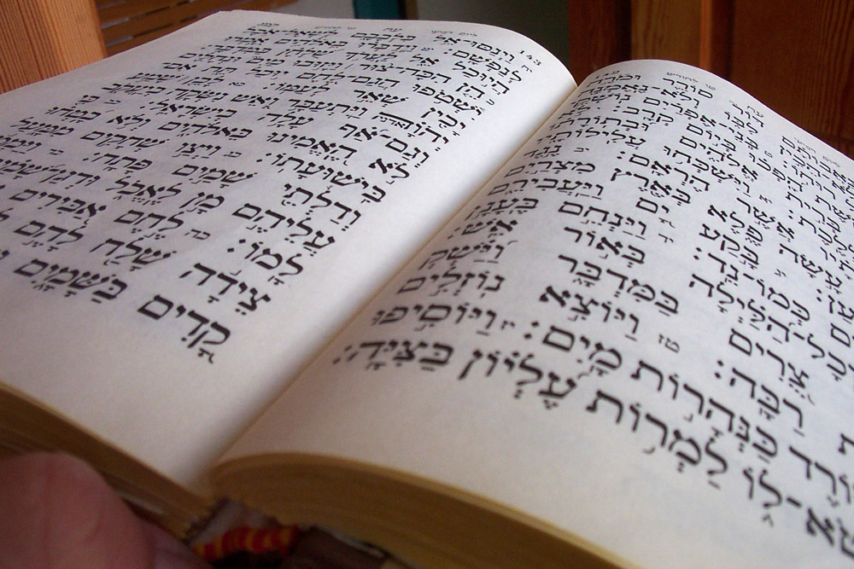
Willingness to Yield up Preconceived Ideas
“All who handle the word of God are engaged in a most solemn and sacred work; for in their research they are to receive light and a correct knowledge, that they may give to those who are ignorant. . . . Everyone who diligently and patiently searches the Scriptures that he may educate others, entering upon the work correctly and with an honest heart,” (TDG 43)

Slide 29
Willingness to Yield up Preconceived Ideas
“laying his preconceived ideas, whatever they may have been, and his hereditary prejudices at the door of investigation, will gain true knowledge. But it is very easy to put a false interpretation on Scripture, placing stress on passages, and assigning to them a meaning, which, at the first investigation, may appear true, but which on further research, will be seen to be false. . . .” (TDG 43)

Slide 30
Willingness to Yield up Preconceived Ideas
“If the seeker after truth will compare scripture with scripture, he will find the key that unlocks the treasure house and gives him a true understanding of the word of God. Then he will see that his first impressions would not bear investigation, and that continuing to believe them would be mixing falsehood with truth” (Ms. 4, 1896; in This Day with God, 43).

Slide 31
Preparation Summary
Heart Preparation
Prayer
Openness to new understanding
Commitment to follow light received
Mind Preparation
Correct hermeneutics
Broad knowledge of Bible and Spirit of prophecy.
Growing (=ongoing) personal acquaintance with the writings themselves

Slide 32
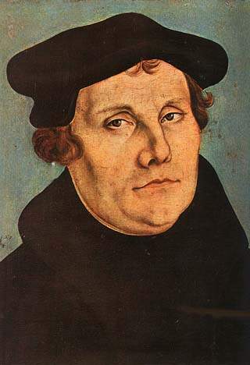
Example of Martin Luther
Luther is the second most written-about human being in history.

Slide 33
Example of Martin Luther
“More books have been written about Martin Luther than about any other single person who has ever lived” (except Jesus Christ).
James Atkinson, Martin Luther and the Birth of Protestantism (Atlanta: John Knox Press, 1981), vi.

Slide 34
Example of Martin Luther
Books by and about Luther take up 36 feet of shelf space in some research libraries.

Slide 35
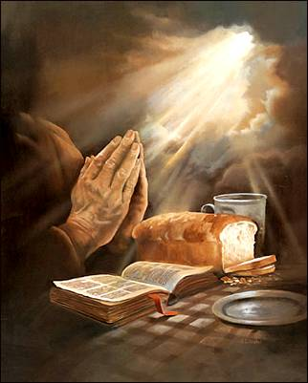
Example of Martin Luther
One secret of Luther’s productivity: he habitually placed heart preparation before study.

Slide 36
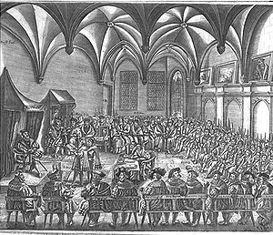
At Augsburg…
“During the struggle at Augsburg, Luther did not fail to devote three hours each day to prayer; and these were taken from that portion of the day most favorable to study.”
D'Aubigne, quoted in Great Controversy, 210.

Slide 37
At Augsburg…
“From the secret place of prayer came the power that shook the world in the Great Reformation. There, with holy calmness, the servants of the Lord set their feet upon the rock of His promises.” Great Controversy, 210.

Slide 38
Summary
1. The doctrines of Revelation, Inspiration, and Illumination imply the need of a careful method to help us ascertain whether we are being led by the Holy Spirit or merely by personal intuition.
2. Definition of hermeneutics: “The study of principles of interpretation.”
3. Concerns of hermeneutics:
A. Words and their individual meaning.
B. Thought and message conveyed by the words.

Slide 39
Summary
Jesus used a hermeneutical method in expounding Scripture: Luke 24:27
Dangers in misuse of hermeneutics: Can be used to evade pointed truth—that is, explain it away or water it down.
Danger in having no hermeneutical method: Disunity because everybody interprets it to suit themselves.

Slide 40
Summary
Four reasons why we need a hermeneutical method:
A. Misinterpretation took place even in Ellen White’s lifetime.
B. Chronological, historical, theological, and linguistic distance.
C. The need for certainty about truth.
D. The need for unity in the church. __________
The next four lectures will present a comprehensive hermeneutical process for the writings of Ellen White.

Slide 41
Acknowledgements
This lecture originally adapted from Roger W. Coon, “EGW and Hermeneutics: Its Importance and Place—An Introduction,” GSEM534 Lecture Outline, Andrews University, April 4, 1995, with further input from Denis Fortin.

Slide 42
PowerPoint
Original by Eric Stubbert, 1999.
Updated by Alexander Rybachek, 2009

