Slide 1
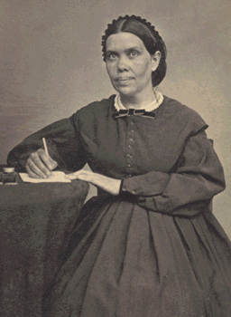
GSEM 534
Lecture 7
A Hermeneutical Method
For the Writings of Ellen G. White:
Part 2: Wide Reading; All Available Data

Slide 2
Hermeneutical Check List
1. Preparation
2. All Available Data
3. Contexts
a. Literary
b. Historical
c. Theological
4. Principles vs. Particular Applications
www.WhiteEstate.org
(lowercase—caps added to clarify spelling)

Slide 3
This Lecture: All Available Data
• Read widely in her writings; don’t depend solely on hits from the CD-ROM.
• As far as possible, study all she wrote on a given topic before drawing conclusions.

Slide 4
Wide Reading; All Available Data
1. Biblical precedent
Jesus, after his resurrection, appeared to two disciples who did not understand why He had to die.
“And beginning at Moses and all the Prophets, He expounded [hermeneuo] to them in ALL the Scriptures that things concerning Himself” (Luke 24:27).

Slide 5
Why It’s So Important to Read Widely, even “All She Wrote” on a Topic

Slide 6
2. An impossible standard?
Comprehensive Index
CD-ROM, Complete Published Writings, Version 3.0
Forthcoming CD-ROM of all unpublished materials.
3. Danger of distortion is inversely proportional to the percentage of the total data examined.

Slide 7
Interpretational Key
“The testimonies themselves will be the key that will explain the messages given, as Scripture is explained by Scripture.”
(1SM 42)

Slide 8
Topics on which Ellen White never wrote directly
1. Cinema, Movies, and Videos
2. Radio
3. Television
4. Chemical/Mechanical contraception
5. Abortion
6. Cremation
7. Organ transplants

Slide 9
Topics on which Ellen White wrote very little
1. Life Insurance
2. Wedding Rings

Slide 10
Topics which Ellen White wrote a great deal
1. Jesus Christ
2. The Holy Spirit

Slide 11
Case Study: Did Ellen White teach that Adventists should not eat eggs?

Slide 12
Sermon, Battle Creek Tabernacle, March 6, 1869
“You place upon your table butter, eggs, and meat, and your children partake of them, . . . And then you come to meeting and ask God to bless and save your children. How high do your prayers go?” (2T 362).

Slide 13
Letter to Brother and Sister E (1869)
“Eggs should not be placed on your table. They are an injury to your children”
(2T 400).

Slide 14
The Story of D. H. Kress, M.D.
Medical Missionary in Australia, 1900-1907
Banned eggs and dairy products, without having adequate nutritional replacements.
Contracted pernicious anemia and was near death.

Slide 15
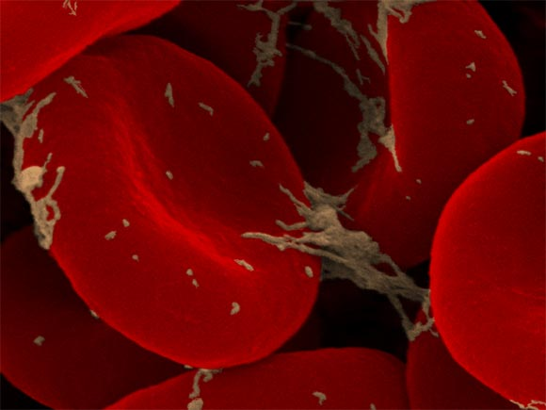
Ellen White’s Emergency Counsel Letter 37, May 1901
“Brother and Sister Kress,
“I have all confidence in you, and I greatly desire that you may have physical health. . . . Some our our people are very careless in regard to health reform. But. . . you must not, in order to be an example to them, be an extremist. You must not deprive yourself of that class of food which makes good blood. . . .

Slide 16
Letter 37, 1901, continued
“Put into your diet something you have left out. It is your duty to do this. . . . Get eggs of healthy fowls. Use these eggs cooked or raw. Drop them uncooked into the best unfermented wine you can find. This will supply that which is necessary for your system. Do not for a moment suppose that it will not be right to do this. . . . You are in danger of taking too radical a view of health reform, and of prescribing for yourself a diet that will not sustain you.

Slide 17
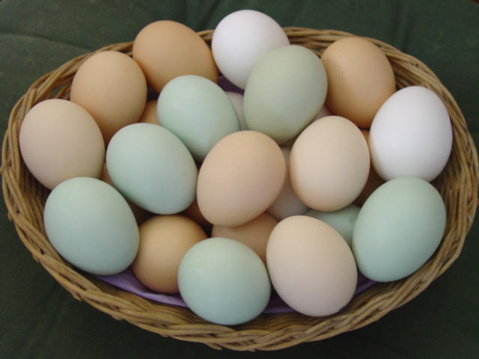
Letter 37, 1901, continued
“Eggs contain properties which are remedial agencies in counteracting poisons. And while warnings have been given against the use of these articles of diet in families where the children were addicted to, yes, steeped in, habits of self-abuse; yet we should not consider it a denial of principle to use eggs of hens which are well cared for and suitably fed” (CD, 203-205).

Slide 18
Dr. Kress’s Reply to Ellen White June 28, 1901
“I can see that the strong view I held with reference to the milk and egg question placed me in danger of going to extremes, and I feel very thankful that the Lord has corrected me. . . . Now with reference to myself as far as I know I am following out carefully all the instruction that God has sent me through you.

Slide 19
Dr. Kress’s Reply to Ellen White June 28, 1901
“I am using both eggs and milk, and I am able to do so without a prick of conscience now. Before this I could not do it without feeling condemned, and I really believe there is hope for me being restored to health, else the Lord would not have sent this message” (quoted in G. R. Knight, Reading Ellen White, 75-76).

Slide 20
The Rest of the Story-- 43 Years Later
Dr. Kress wrote an unpublished autobiographical manuscript
in January 1944
“‘Some honest souls,” he wrote, “have taken an extreme position in regard to some of the statements made by Sister White regarding the use of animal food products, especially milk and eggs.”

Slide 21
D. H. Kress, unpublished MS, January 1944, continued
Speaking to his own extremes, he said, “I ran down in health almost to the point of death. . . .
“Sister White saw me in vision and wrote me several letters, pointing out the cause of my condition, and urging me to make a change in my dietetic habits. . . .

Slide 22
D. H. Kress, unpublished MS, January 1944, continued
“After receiving this message, I at once began to make reforms by using eggs as directed, and milk, and with God’s blessing I made a speedy recovery. . . . This was over forty years ago. I have now about reached my eighty-second year of life, and am still able to spend three hours daily in my office at the Sanitarium.

Slide 23
D. H. Kress, unpublished MS, January 1944, continued
“For the health so graciously granted me I am indebted to the messages that came to me at a time when a recovery seemed hopeless form a human standpoint. I still follow out the instruction by using milk and eggs’” (D. H. Kress, Jan. 6, 1944, as quoted in G. R. Knight, Reading Ellen White, 76).

Slide 24
Why then the warning to Brother and Sister E?
1. The adolescent sons in the “E” family were addicted to sexual indulgence (2T 392; cf. CD 204).
2. God had shown Ellen White that eggs contain substances that tend to stimulate sexual desire. “This kind of food--eggs and animal flesh-- feeds and inflames the animal passions. This makes it very difficult for them to overcome the temptation to indulge in the sinful practice of self-abuse which in this age is almost universally practiced.

Slide 25
Why the warning to Brother and Sister E?
3. The letter to Brother and Sister E was really giving very sensible advice, that those whose sexual drives are already out of control should avoid substances that make the situation worse.

Slide 26
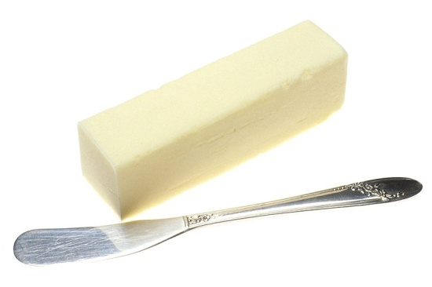
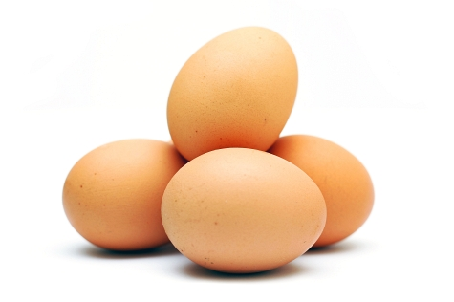
For Those in Different Situations She Gave Different Counsel
A Statement on the Benefits of Eggs
“Milk, eggs, and butter should not be classed with flesh meat. In some cases the use of eggs is beneficial” (7T 135).

Slide 27
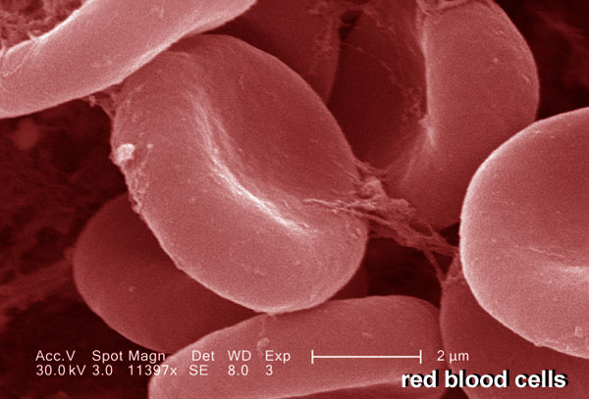
Who May NEED to Use Eggs?
1. “Persons whose blood-making organs are feeble, especially if other foods to supply the needed elements cannot be obtained” (MH 320).
2. Persons in “[developing] countries or poverty-stricken districts, where fruit and nuts are scarce” (MH 320, 9T 163).
3. Persons anywhere who because of poverty cannot afford the variety of food they would need to replace milk and eggs (CD 358, 9T 163).

Slide 28
Who Should Use Few or No Eggs?
1. “Persons . . . in whom [sexual] passions are strong need to avoid the use of stimulating foods” (MH 320).
2. “Persons in full flesh” [overweight] may need to avoid eggs, [probably because of the cholesterol] (MH 320).

Slide 29
A Prediction and a Promise
1. Around 1900, some sincere, but misguided Adventists advocated health reform “in its most extreme form,” with the result that “harm” was being done.
2. Attempting to bring balance, EGW, while continuing to advocate the discontinuance of flesh foods, tea, and coffee, nevertheless held that urging abstinence from milk, cream, butter, and eggs for ALL people everywhere, regard-less of their situation, was going too far.

Slide 30
“The Time Will Come”
3. She declared, that “the time will come” when we will need to discard from the diet all animal products; but “when the time comes. . . God will reveal it. No extremes in health reform are to be advocated” (Letter 37, 1901, in CD 358, 359).

Slide 31
Has that Time Come?
1. Abundant scientific evidence of rampant animal disease.
2. In many countries, a variety of vegetable-based alternatives.
3. For example, we now know that Vitamin B12 would have cured Dr. Kress’s anemia.

Slide 32
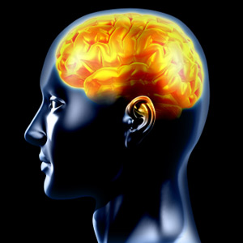
A Personal Decision
Romans 14:5
“Let each be fully convinced in
his [or her] own mind.”

Slide 33
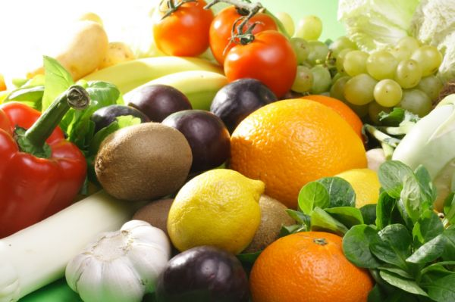
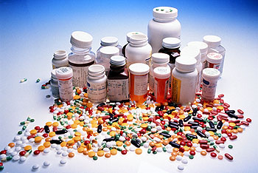
Factors to Consider
1. Nutritional Benefit
2. Risk of Disease
3. Cost
4. Individual Differences

Slide 34
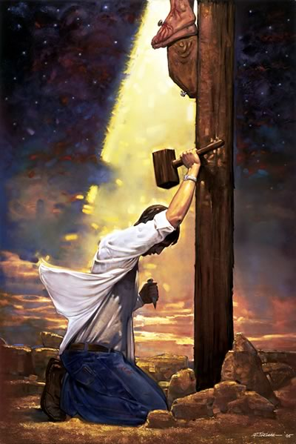
If You Decide to Change, Expect Some Struggle
Galatians 5:17
“For the sinful nature desires what is contrary to the Spirit, and the Spirit what is contrary to the sinful nature” (NIV).

Slide 35
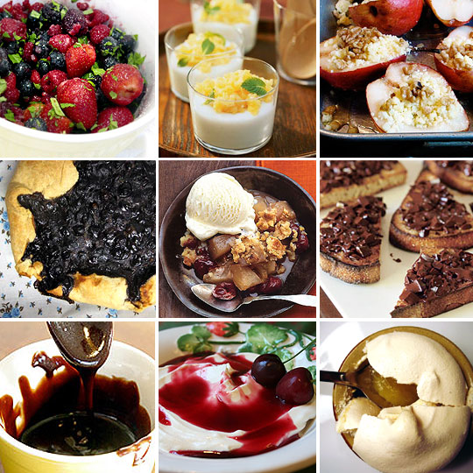
A Second Case Study
Is it a sin to eat desserts?

Slide 36
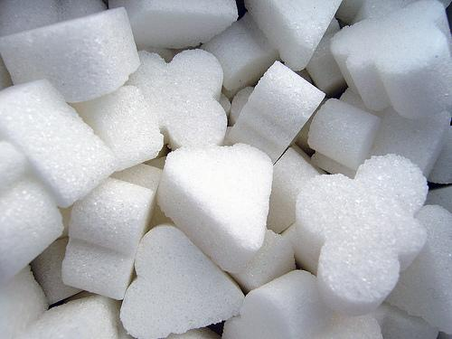
Dessert Problem #1: Excessive Use of Sugar
“Far too much sugar is ordinarily used in food. Cakes, sweet puddings, pastries, jellies, jams, are active causes of indigestion”
(CD 333).

Slide 37
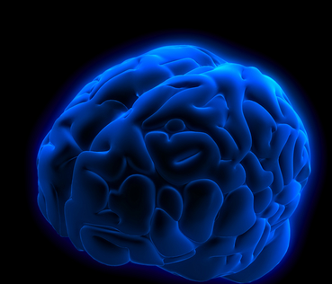
Excessive Use of Sugar Dessert Problem #1, continued
“Sugar clogs the system. It hinders the working of the living machine. Anything that hinders the active motion of living machinery affects the brain very directly”
(2T 369, 370).

Slide 38
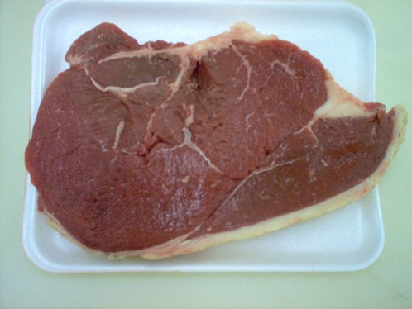
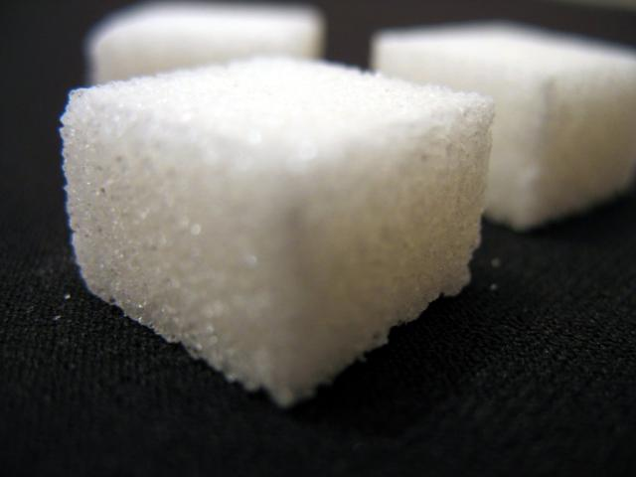
Excessive Use of Sugar Dessert Problem #1, continued
3. “From the light given me, sugar, when largely used, is more injurious than meat” (2T 370).

Slide 39
Dessert Problem #2: Milk, Eggs, and Sugar in Combination
1. Many people “use a great amount of milk and sugar. These clog the system, irritate the digestive organs, and affect the brain” (2T 370).

Slide 40
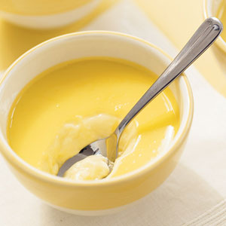
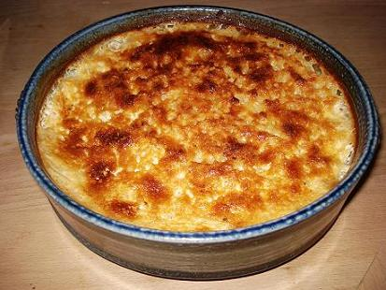
Dessert Problem #2, continued Milk, Eggs, and Sugar in Combination
“Especially harmful are the custards and puddings in which milk, eggs, and sugar are the chief ingredients”
(CD 333).

Slide 41
Dessert Problem #2, continued Milk, Eggs, and Sugar in Combination
3. “Could we know that animals were in perfect health, I would recommend that people eat flesh meats sooner than large quantities of milk and sugar. It would not do the injury that milk and sugar do” (2T 369).

Slide 42
Scientific Support:
“All Cholesterol Is Not Equal”
by Neil Nedley, M.D.
In Lifestyles, the Newsletter of the Lifestyle Center of America,
Spring 1999, page 3.

Slide 43
Oxidized Cholesterol
1. Cholesterol exposed to air combines with oxygen.
2. “Oxidized cholesterol . . . can cause immediate damage to the arteries.”
3. “Oxidized cholesterol may raise blood cholesterol levels more than pure cholesterol alone.”
4. Oxidized cholesterol can damage arteries “even if your blood cholesterol levels stay normal.”

Slide 44
What Foods Contain Oxidized Cholesterol?
1. “The most harmful combination of cholesterol oxidation products was found in custard mix where sugar, milk, and eggs were combined. The dried mix was apparently exposed to air for a considerable period of time, due to its long shelf life. . . . Ice cream is the most common form of custard.”

Slide 45
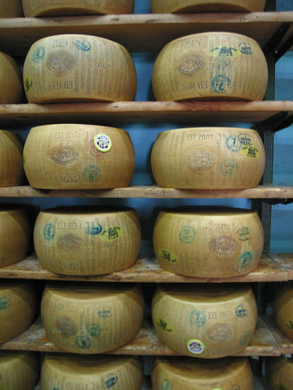
Oxidized Cholesterol, continued
2. “Pancake mixes containing eggs and dried powdered milk were equally as harmful as custard.”
3. The third most harmful item was grated and canned Parmesan cheese; “it proved to be as damaging to the arteries as lard” (Neil Nedley, M.D., “All Cholesterol is Not Created Equal,” Lifestyles, Spring 1999, 3).

Slide 46
So--Should desserts be banned?
Some Adventists have concluded that the only safe approach is a total ban on desserts.

Slide 47
The Case of Husband B 2T 378-379
1. “He took extreme views” of health reform.
2. Enforced “rigid rules” on his wife and family.
3. Two children died of malnutrition.
4. Mrs. B was near starvation.

Slide 48
Ellen White’s Counsel to Save the Life of Mrs. B
“When she needed . . . extra food, . . . it was not allowed her. Her system craved material to convert into her blood, but he would not provide it. A moderate amount of milk and sugar, a little salt, white bread raised with yeast for a change, graham [whole wheat] flour prepared in a variety of ways by other hands than her own,

Slide 49
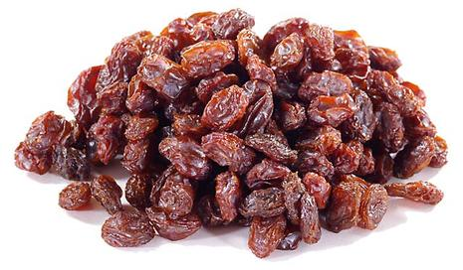
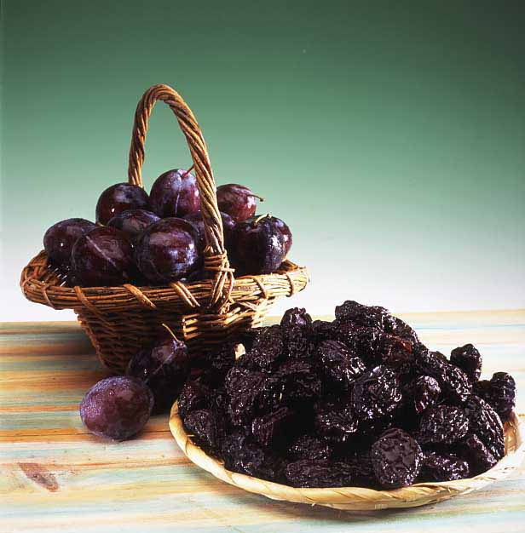
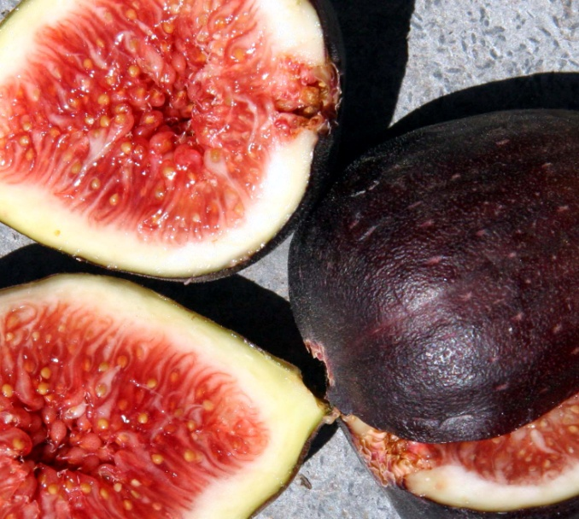
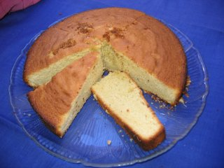
Ellen White’s Counsel to Save the Life of Mrs. B
“plain cake with raisins, rice pudding with raisins, prunes and figs, occasionally, and many other dishes I might mention, would have answered the demand of appetite”
(2T 383-384).

Slide 50
A Balanced View of Desserts
“Sugar, when largely used” is not healthful (2T 370).
Foods, “in which milk, eggs, and sugar are the chief ingredients” are not the most healthful (CD 33).
But she did not forbid the “moderate” use of sugar, even with milk (2T 384).

Slide 51
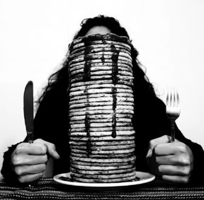
Balanced View of Desserts, continued
4. “Plain, simple pie may serve as a dessert, but when one eats two or three pieces merely to gratify an inordinate appetite, he unfits himself for the service of God” (CD 333).

Slide 52
Balanced View of Desserts, continued
5. “Lemon pie should not be forbidden,” she wrote, [even though lemon pie usually includes some sugar and eggs] (CD334).

Slide 53
Balanced view of desserts, continued
6. Her personal practice, which she insisted (CD 491) was not a rule for others:
A. “We have always used a little milk and some sugar. This we have never denounced, either in our writing or in our preaching” (1873- CD 330).
B. “We have no sugar [bowl] on our table. Our [fruit] sauce. . . is . . . sweetened [with sugar] as is required before being put on the table” (CD 330).

Slide 54
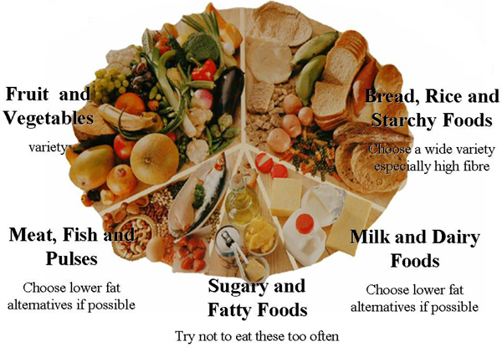
Balanced View of Desserts, continued
7. “The dessert should be placed on the table and served with the rest of the food,” so people can better plan how much to eat (CD 334).

Slide 55
Advice of S. P. S. Edwards, M.D.
“We must not take a single testimony or paragraph in a book as the last word in what she believed or advocated.”

Slide 56
S. P. S. Edwards, quoting EGW
“In a letter in my file, she [Ellen White] says:
‘I have not written a book of proverbs. Under certain circumstances I may make a statement suitable to the occasion. Under other circumstances I may make another statement on the same subject. Take the two together and you have a balanced opinion. Either alone might be one sided. Study all my writings and not a paragraph or few lines here and there. And the same applies to the Bible.’”
S.P.S. Edwards to E. K. Vande Vere, Oct. 29, 1957, p. 58, Center for Adventist Research, AU

Slide 57
Tip for exam preparation: begin memorizing the hermeneutical checklist:
1. Personal preparation
2. Wide Reading; All Available Data
3. Contexts
a. Literary
b. Historical
c. Theological
4. Principles vs. Particular Applications
5. www.WhiteEstate.org

Slide 58
AcknowledgementS
This lecture adapted from Roger W. Coon, “EGW and Hermeneutics: Jemison’s First Rule: Take ALL that the Prophet Says Before Drawing Your ‘Bottom-Line’ Conclusions (Part II of Four Parts),” GSEM 534 Lecture outline, April 5, 1995, with further input from Denis Fortin.
PowerPoint by Eric Stubbert, 2000; updated by Alexander Rybachek, 2009.

Slide 59
Additional Sources
Jemison, T. Housel. A Prophet among You (1955), 438- 449.
White, Arthur L. “Helpful Points in the Interpretation and Use of the Ellen G. White Writings,” in Compre- hensive Index to the Writings of Ellen G. White (1963), 3:3211-3216.
Olson, Robert W. “Hermeneutics: Guiding Principles in the Interpretation of the Bible and the Writings of Ellen G. White.” White Estate Shelf Document (1986).
Knight, George R. Reading Ellen White (1997).
Douglass, Herbert E. Messenger of the Lord (1999), 372-443.

