Slide 1
GSEM534 Issues in Ellen White Studies
H E R M E N E U T I C S I I I :
Literary, Historical, and Theological Contexts

Slide 2
Literary Context
“In order to sustain erroneous doctrines or unchristian practices, some will seize upon passages of Scripture separated from the context, perhaps quoting half a single verse as proving their point, when the remaining portion would show the meaning to be quite the opposite. With the cunning of the serpent they entrench themselves behind disconnected utterances construed to suit their carnal desires. Thus do many willfully pervert the word of God” (GC 521).

Slide 3
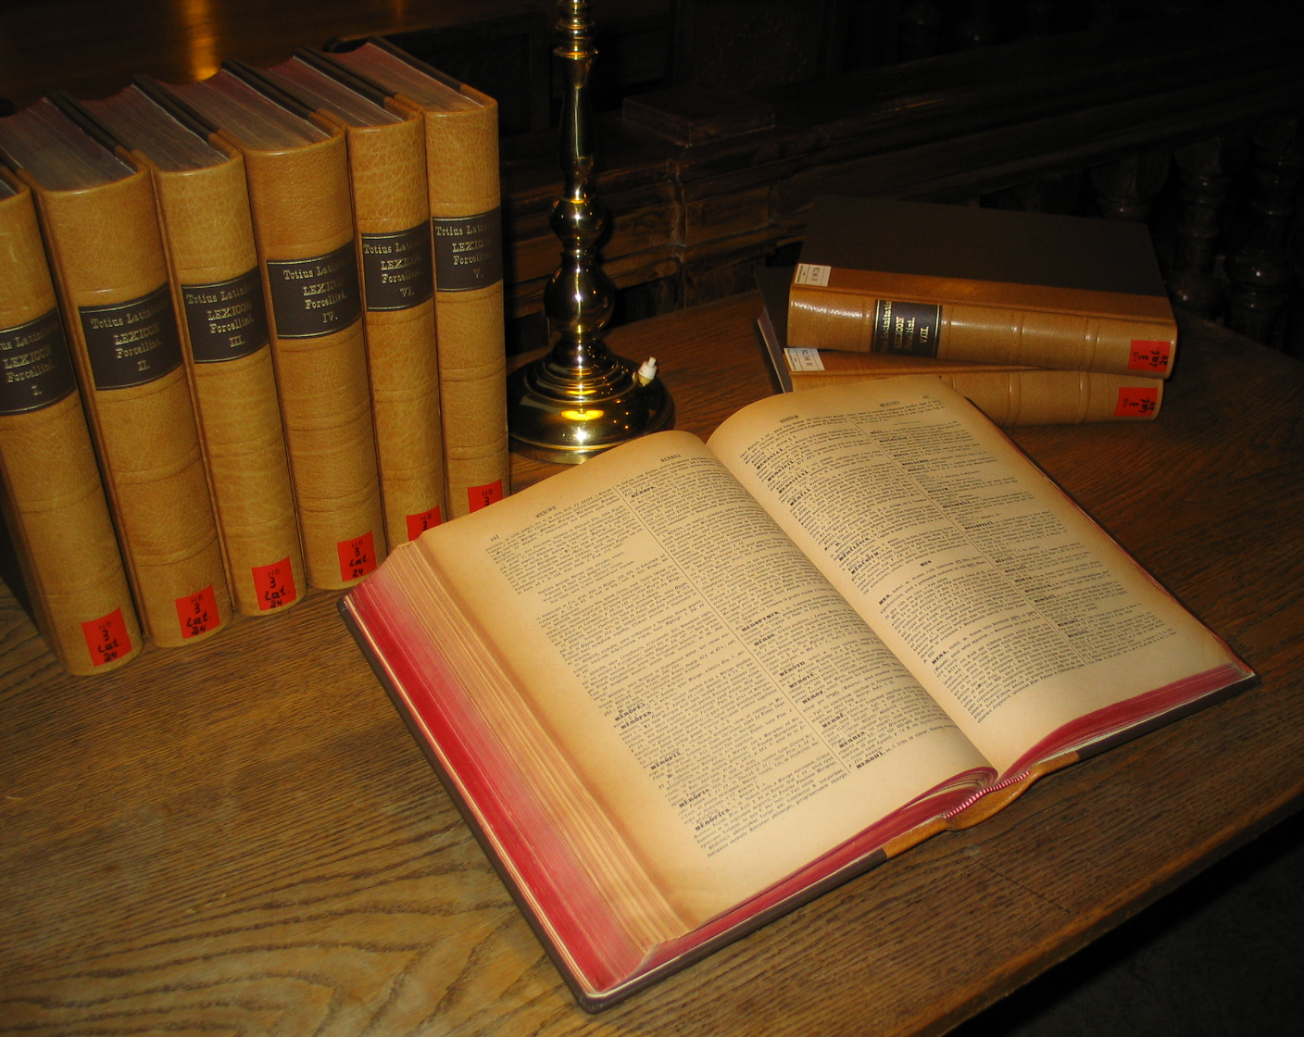
Aspects of Literary Context
1. Original language if possible
2. Word definitions
a. By historical dictionary
b. By comparing usage in this and other contexts.

Slide 4
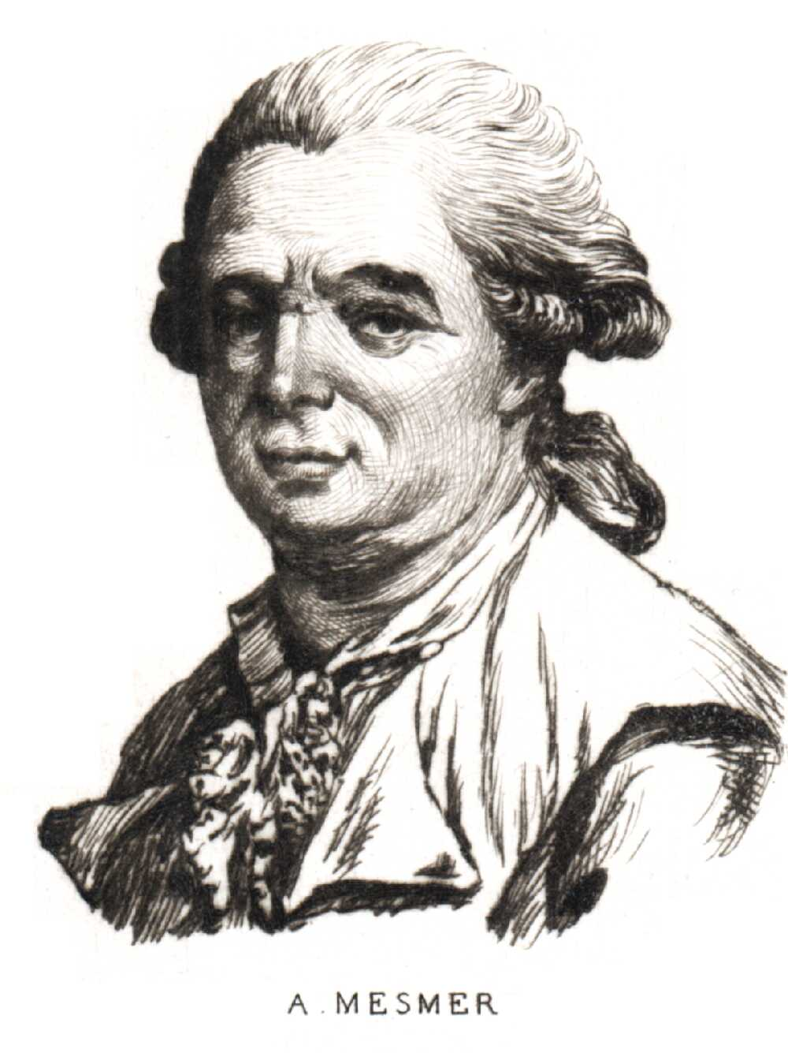
Example of change in word meaning: “mesmerism”
Original meaning: a general term for all the medical and psychological theories of F. A. Mesmer, Austrian physician (1733-1815).
Later meaning: Hypnotism (one of Mesmer’s theories).

Slide 5
Example of EGW using “mesmerism” with its original meaning
“Phrenology and mesmerism are very much exalted. They are good in their place, but they are seized upon by Satan as his most powerful agents to deceive and destroy souls.” 1T 296 (1862)

Slide 6
A later statement substitutes a phrase, probably because of the connotations that “mesmerism” had acquired (1884)
“The advantages he (Satan) takes of the sciences, sciences which pertain to the human mind, is tremendous. Here, serpent-like, he imperceptibly creeps in to corrupt the work of God.” Signs of the Times, Nov. 6, 1884, par. 1

Slide 7
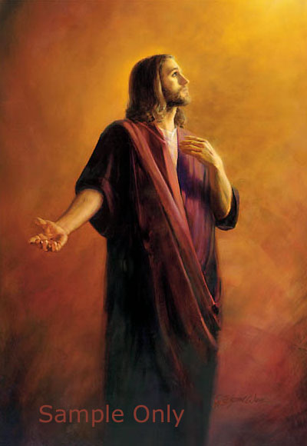
“The true principles of psychology are found in the Holy Scriptures. Man knows not his own value. He acts according to his unconverted temperament of character, because he does not look unto Jesus, the author and Finisher of his faith. He who comes to Jesus, he who believes on Him and makes Him his Example, realizes the meaning of the words, ‘To them gave He power to become the sons of God’” (ML 176).

Slide 8
Aspects of Literary Context, continued
3. Is the expression intended to be taken as:
a. Precise statement of empirical fact?
b. Figure of speech?

Slide 9
Figures of Speech
Hyperbole (intentional overstatement): “I suppose that the world itself could not contain the books that would be written.” (John 21:25)
Metaphor (this is that)
Simile (this is like that)
Synecdoche (the part for the whole, the general for the particular; or vice versa).
“My lips shall greatly rejoice when I sing to you,
And my soul, which you have redeemed.”
Ps 71:23

Slide 10
Aspects of Literary Context, continued
c. Approximation
40 or 38 rooms in the Paradise Valley Sanitarium (1 SM 38).
d. Generalizations, with possible exceptions
“A youth not out of his teens is a poor judge of the fitness of a person as young as himself to be his companion for life (MYP 452).

Slide 11
Historical Context
The time, place and circumstances in which the message was originally given

Slide 12
General Principles Regarding Historical Context
1. 1875: “That which can be said of men under certain circumstances cannot be said of them under other circumstances” (3T 470; reprinted in 5T 670).
2. 1904: “God wants us all to have common sense, and He wants us to reason from common sense. Circumstances alter conditions. Circumstances change the relation of things” (3 SM 217).
3. 1911: “Regarding the testimonies, nothing is ignored; nothing is cast aside; but time and place must be considered” (1 SM 57).

Slide 13
Aspects of Historical Context
Time
Place
Circumstances

Slide 14
Case Studies in Time
The Time when Probation Closes
“We are still in probationary time”
(Letter 20, Jan. 16, 1898).

Slide 15
1. The statement was true when written, in 1898.
2. Is it true today, more than a century later?
Most SDAs hold that this is still true.
Jeanine Sautron, the French woman who claimed to have been given EGW’s prophetic gift, thought probation for all SDA’s closed in the spring of 1991.
3. Even though EGW’s statement “We are still in probationary time,” is still true today, the time is coming when it will not be true (Rev. 22:11).

Slide 16
Case studies in “time”
Is the Voice of the General Conference
To Be Heeded as the Voice of God?
(Note how her position changed between 1875 and 1911)

Slide 17
In the GC the Voice of God?
Yes, 1875: “When the judgment of the General Conference, which is the highest authority that God has upon the earth, is exercised, private independence and private judgment must not be maintained, but be surrendered” (3T 492).

Slide 18
Situation Changing
1895: “The voice of the General Conference has been [note: past tense] regarded as an authority to be heeded as the voice of the Holy Spirit. But when members of the General Conference Committee become entangled in business affairs and financial perplexities, the sacred, elevated character of their work is in a great degree lost” (Ms 33, 1895, in MR #1118).

Slide 19
NO LONGER
1896: “The voice from Battle Creek which has been [again, note: past tense] regarded as authority in counseling how the work should be done, is no longer the voice of God” (Letter 4, July 1, 1896).
1898: “It has been some years since I have considered the General Conference as the voice of God” (Letter 77, Aug. 26, 1898).

Slide 20
Is the GC the Voice of God? Situation Improving, 1901 GC
“The people have lost confidence in those who have the management of the work. Yet we hear that the voice of the Conference is the voice of God. Every time I have heard this, I have thought it was almost blasphemy. . . .”
(April 1, 1901, day before the session opened)

Slide 21
Is the GC the Voice of God?
“The voice of the Conference ought to be the voice of God, but it is not, because
[1] some in connection with it are not men of faith and prayer, they are not men elevated by principle. . . .
[2] Two or three voices are not to control everything in the [whole world] field” (Ms 37, April 1, 1901, pp. 1, 8).

Slide 22
April 2, 1901, Opening Day of GC Session
“That these men should stand in a sacred place, to be as the voice of God to the people, as we once believed the General Conference to be, that day is past. What we want now is reorganization. We want to begin at the foundation, and to build upon a different principle” (1901 GCB, p. 25, col. 1).

Slide 23
April 4, 1901, EGW Enthusiastic about Structural Changes
“I was to say, from the light given me by God, there should have been, years ago, organizations such as are now [being] proposed” (1901 GCB, 68).

Slide 24
April 23, 1901, Closing day of GC Session
“Wrongs--serious wrongs--have been committed in Battle Creek. I did not know how we would get along at this meeting. . .
“Who do you suppose has been among us since this Conference began? Who has kept away the objectionable features that generally appear in such a meeting? Who has walked up and down the aisles of this Tabernacle?--the God of heaven and his angels.”

Slide 25
April 23, 1901, Closing day of GC Session
“We have been trying to organize the work in the right lines. The Lord has sent His angels, . . . telling us how to carry the work forward. I was never more astonished in my life than at the turn things have taken at this meeting. This is not our work. God has brought it about. . . . God’s angels have been walking up and down in this congregation.” (1901 GCB, 463-464).

Slide 26
Is the GC the Voice of God? After Reorganization--Yes
June 1901, two months after GC Session, Ellen White to J. Edson White:
“Your course would have been the course to be pursued, if no changes had been made in the General Conference. But a change has been made, and many more changes will be made. . . .”

Slide 27
Is the GC the Voice of God? After Reorganization, Yes
“It hurts me to think that you are using the words which I wrote prior to the Conference [to apply to GC leaders after the Conference]. Since the Conference great changes have been made.
“A terribly unjust course has been pursued in the past. A want of principle has been revealed. But in pity to His people, God has brought about changes. . . .”

Slide 28
Is the GC the Voice of God? After Reorganization--Yes
“The course of action which before the Conference might have been a necessity is no longer a necessity, for the Lord Himself interposed to set things in order. . . .” (Letter 54, June 1901).

Slide 29
Is the GC the Voice of God?
1909: “God has ordained that the representatives of His church from all parts of the earth, when assembled in a General Conference[Session], shall have authority” (9T 261).

Slide 30
Is the GC the Voice of God? In 1911--Yes
“God has invested His church with special authority and power which no one can be justified in disregarding and despising, for he who does this despises the voice of God” (AA 164).

Slide 31
Summary: “Time Factors”
What is true at one time, may not be true at another time.
Therefore, “time and place must be considered,” (1 SM 57) in interpreting historical writings.

Slide 32
Case Studies in “Place” (Audience)

Slide 33
Caution against Misapplication
“We should be very cautious not to advance too fast, lest we be obliged to retrace our steps. In reforms we would better come one step short of the mark than to go one step beyond it. And if there is error at all, let it be on the side next to the people”
(3T 21:0).

Slide 34
James White, editorial Review and Herald, March 17, 1868
“She [Ellen White] works to this disadvantage, namely: she makes strong appeals to the people, which a few feel deeply, and take strong positions, and go to extremes. Then to save the cause from ruin in consequence of these extremes, she is obliged to come out with reproofs for extremists in a public manner.

Slide 35
James White, editorial, continued
“This is better than to have things go to pieces; but the influence of both the extremes and the reproofs are terrible on the cause, and brings upon Mrs. W. a three-fold burden. Here is the difficulty: What she may say to urge the tardy, is taken by the prompt to urge them over the mark. And what she may say to caution the prompt, zealous, incautious ones, is taken by the tardy as an excuse to remain too far behind.”

Slide 36
Roger Coon’s Summary Regarding ‘Place’
“Thus we note that the proper identification of the audience to whom a particular prophetic message may be sent, may, contextually, be crucial to a correct understanding of the prophet’s intended meaning for that particular message.”

Slide 37
Theological Context
Theological details or obscure points are to be interpreted in harmony with the great central teachings of the Bible and Ellen White’s writings (1 SM 42).
“The testimonies themselves will be the key that will explain the messages given, as Scripture is explained by Scripture”
(1 SM 42).

Slide 38
Theological Context
1. Scripture
Ellen White’s purpose was to call us back to Scriptures that had been neglected. Everything she wrote presupposes that real Christians will live their whole lives under the authority and in the context of Scripture.

Slide 39
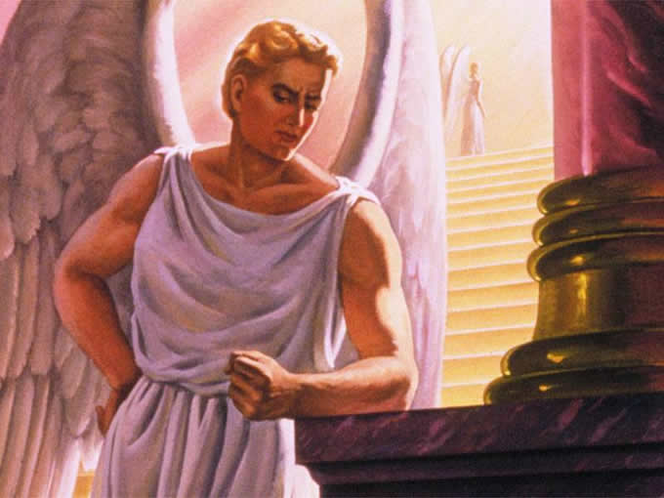
Theological Context
2. Great Controversy Theme
“The central theme of the Bible, the theme about which every other in
the whole book clusters, is the
redemption plan, the restoration
in the human soul of the image
of God” (Ed 125).

Slide 40
2. Great Controversy = “Grand Central Theme”
“The Bible is its own expositor. Scripture is to be compared with scripture. The student should learn to view the word as a whole, and to see the relation of its parts. He should gain a knowledge of its grand central theme, of God’s original purpose for the world, of the rise of the great controversy, and of the work of redemption.

Slide 41
Great Controversy Theme
“[The student of the Bible] should understand the nature of the two principles that are contending for supremacy, and should learn to trace their working through the records of history and prophecy. . . . He should see how this controversy enters into every phase of human experience; how in every act of life he himself reveals the one or the other of the two antagonistic motives; and how whether he will or not, he is even now deciding upon which side of the controversy he will be found” (Ed 190-191).

Slide 42
Great Controversy Theme
For a more thorough exposition, see Herbert E. Douglass, Messenger of the Lord, 256-260, 268-270.

Slide 43
Theological Context
3. The Ellipse of truth unites paradoxical principles that are both true.

Slide 44
Ellipse of Truth
Gospel
Christ as Savior
God’s Role in Salvation
Faith
Law
Christ as Lord
Man’s role in salvation
Action
See Herbert E. Douglass, Messenger
of the Lord, 260-265, 268-277.

Slide 45
Theological Context
4. Righteousness by Faith
Testimony of a long time legalist, finally converted:
“Righteousness by faith--for years I never saw it in Ellen White, but once you see it, it’s on every page.”

Slide 46
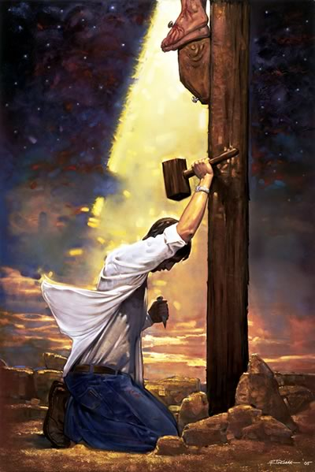
Theological Context
5. Radical Discipleship
Uncompromising devotion to Jesus. This is why the Testimonies are so stringent, because written out of a white-hot devotion to Jesus and the realization that every sin or deception we cling to, jeopardizes our eternity and crucifies Jesus afresh.

Slide 47
The Effect of Compilations on Context
Advantage 1: By grouping together similar statements on a topic, compilations emphasize the conceptual or theological context.
Disadvantage 1: They de-emphasize the original literary and historical context.

Slide 48
The Effect of Compilations on Context
Advantage 2: The multiplicity of witnesses intensifies the theological or conceptual context.
Disadvantage 2: Super-concentration on one topic can distort the impact on an uninformed reader. Illustration: CS.

Slide 49
Exam Preparation
1. Know the hermeneutical check list
2. Study the Great Controversy theme and the Elliptical principle in Messenger of the Lord, 256-277.

Slide 50
Acknowledgements
Roger W. Coon, “Ellen White and Hermeneutics: Jemison’s Second Rule,” GSEM Lecture Outline, Andrews University, 1995. (case studies in “time” and “place”).
Douglass, Herbert E., Messenger of the Lord, 256-277. (Great Controversy theme and Ellipsis of Truth)

Slide 51
Websites
www.andrews.edu/~jmoon
www.andrews.edu/~fortind

