Slide 1
GSEM 534 Issues in Ellen White Studies
H E R M E N E U T I C S I V :
Principles and their Particular Applications

Slide 2
Hermeneutical Process
1. Preparation
2. All Available Data
3. Contexts
a. Literary
b. Historical
c. Theological
4. Principles and Applications
(Ideals and Adaptations)
5. www.WhiteEstate.org

Slide 3
Definitions
Principle: an unchanging rule of human behavior.
A. True in all historical time periods.
True in all places.
“God has established immutable principles, which He cannot change without a revision of His whole nature.” Testimonies, 4:312

Slide 4
Definitions
Particular: the application of some timeless and universal principle to a particular time and place.

Slide 5
Ellen White on Principles and Particulars
“The Bible is the guidebook that is to decide the many difficult problems that rise in minds that are selfishly inclined. It is the reflection of the wisdom of God, and not only furnishes great and important principles, but supplies practical lessons for the life and conduct of man toward his fellow man. It gives minute particulars that decide our relations to God and to each other.” Letter 22, 1896, cited in UL 187.

Slide 6
Alternative Terms for Principles and Particulars
W. C. White: Principles and Precepts
(3 SM 221:3)
Roger W. Coon: Principles and Policies
Ideals vs. Adaptations. Here “ideal” is used in the sense of the very best, the preferred choice, the goal to be aimed at, but which may not always be possible in every situation.

Slide 7
Example of “Ideal” vs. “Necessary”
“God gave our first parents the food He designed that the race should eat. It was contrary to His plan to have the life of any creature taken. There was to be no death in Eden. The fruit of the trees in the garden, was the food man's wants required. CCh

Slide 8
“Ideal” vs. “Necessity”
“God gave man no permission to eat animal food until after the flood. Everything had been destroyed upon which man could subsist, and therefore the Lord in their necessity gave Noah permission to eat of the clean animals which he had taken with him into the ark. But animal food was not the most healthful article of food for man.” CCh 228

Slide 9
“Ideal” vs. “Necessity”
“After the Flood,” God “permitted that long-lived race to eat animal food to shorten their sinful lives. Soon after the Flood the race began to rapidly decrease in size, and in length of years. CCh 228.2

Slide 10
“Ideal” vs. “Necessity”
“In choosing man's food in Eden, the Lord showed what was the best diet; in the choice made for Israel He taught the same lesson. He brought the Israelites out of Egypt and undertook their training, that they might be a people for His own possession. Through them He desired to bless and teach the world. He provided them with the food best adapted for this purpose, not flesh, but manna, ‘the bread of heaven.’” CCh 228.3

Slide 11
“Ideal” vs. “Necessity”
“It was only because of their discontent and their murmuring for the fleshpots of Egypt that animal food was granted them, and this only for a short time. Its use brought disease and death to thousands. Yet the restriction to a non-flesh diet was never heartily accepted. It continued to be the cause of discontent and murmuring, open or secret, and it was not made permanent.” CCh 228.3

Slide 12
“Ideal” vs. “Necessity”
“It was only because of their discontent and their murmuring for the fleshpots of Egypt that animal food was granted them, and this only for a short time. Its use brought disease and death to thousands. Yet the restriction to a non-flesh diet was never heartily accepted. It continued to be the cause of discontent and murmuring, open or secret, and it was not made permanent.” CCh 228.3 [cf. “because of their hardness of heart.”]

Slide 13
“Ideal” vs. “Necessity”
“Upon their settlement in Canaan, the Israelites were permitted the use of animal food, but under careful restrictions which tended to lessen the evil results. The use of swine's flesh was prohibited, as also of other animals and of birds and fish whose flesh was pronounced unclean. Of the meats permitted, the eating of the fat and the blood was strictly forbidden. {CCh 228.4}

Slide 14
“Ideal” vs. “Necessity”
“Only such animals could be used for food as were in good condition. No creature that was torn, that had died of itself, or from which the blood had not been carefully drained, could be used as food. {CCh 228.5}

Slide 15
“Ideal” vs. “Necessity”
“By departing from the plan divinely appointed for their diet, the Israelites suffered great loss. They desired a flesh diet, and they reaped its results. They did not reach God's ideal of character or fulfill His purpose. The Lord "gave them their request; but sent leanness into their soul." Psalm 106:15. They valued the earthly above the spiritual, and the sacred pre-eminence which was His purpose for them they did not attain. CCh 228-229.

Slide 16
“Ideal” vs. “Necessity”
“Those who eat flesh are but eating grains and vegetables at second hand; for the animal receives from these things the nutrition that produces growth. The life that was in the grains and vegetables passes into the eater. We receive it by eating the flesh of the animal. How much better to get it direct, by eating the food that God provided for our use! CCh 229.1

Slide 18
Particulars are Based on Principles
W. C. White, in conversation with E. G. White:
“In my study of the Bible and in my study of your writings, I have come to believe that there is a principle underlying every precept, and that we cannot understand properly the precept without grasping the principle” (3 SM 221:3, emphasis supplied).

Slide 19
The Truth about Principles and Particulars
1. Principles are timeless and universal.
2. Particulars are applications of principle(s) to a particular concrete situation in time and space.
3. Without specific concrete application, a principle remains abstract and theoretical. To become real in human life, principles have to be articulated in terms of specific behavior.

Slide 20
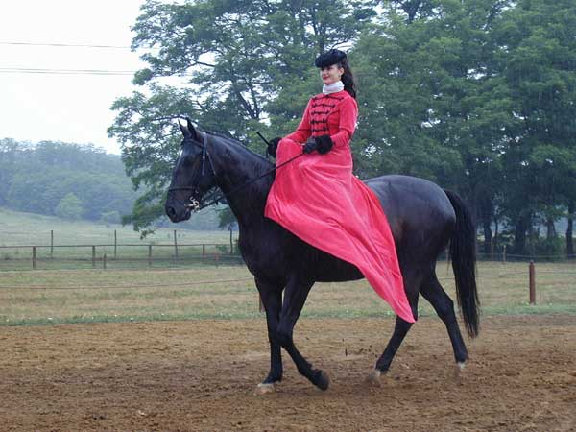
Case 1: Teaching Girls to Harness and Drive Horses
Ellen White’s counsel in 1903: “If girls . . . could learn to harness and drive horses . . . they would be better fitted to meet the emergencies of life” (Ed. 216-217).

Slide 21
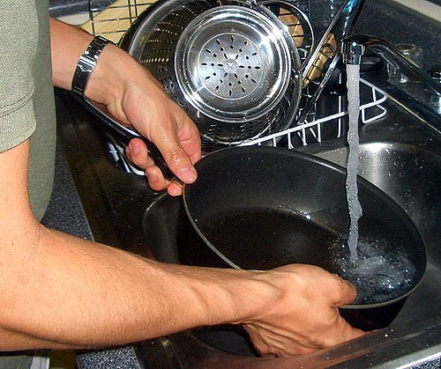
Immediate Literary Context Education, 216-217
“Since both men and women have a part in homemaking, boys as well as girls should gain a knowledge of household duties. To make a bed and put a room in order, to wash dishes, to prepare a meal, to wash and repair his own clothing, is a training that need not make any boy less manly; it will make him happier and more useful.”

Slide 22
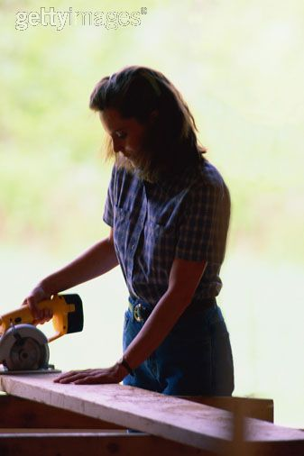
Literary Context
“And if girls in turn, could learn to harness and drive a horse, and to use the saw and the hammer, as well as the rake and the hoe, they would be better fitted to meet the emergencies of life” (Ed 216-217).

Slide 23
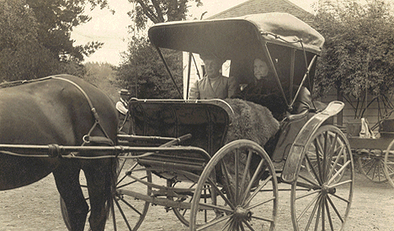
Historical Context
In 1903, horses were still the main means of transportation.

Slide 24
Principle
Both men and women need practical skills that free them from dependence on others, and fit them for life’s practical emergencies.

Slide 25
Analogous Applications Today
Driver’s Education
Personal Auto Care—routine maintenance, tune-up, and minor repairs.

Slide 26
Same Principle, Different Application
Typing and computer skills, for self-reliance in academic emergencies.

Slide 27
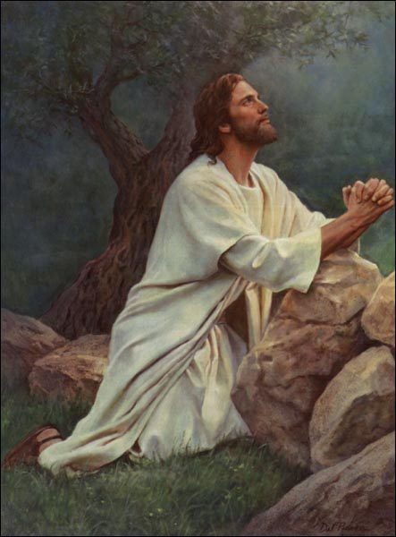
Case Study 2: Physical Posture in Prayer
“As I beheld him standing upright upon his feet while his lips were about to open in prayer to God, my soul was stirred within me to give him an open rebuke. Calling him by name, I said, ‘Get down upon your knees.’ This is the proper position always.” (2SM 311).

Slide 28
Interpretative Question
Does the phrase, “proper position always,” mean:
(1) always appropriate?
or (2) always necessary?

Slide 29
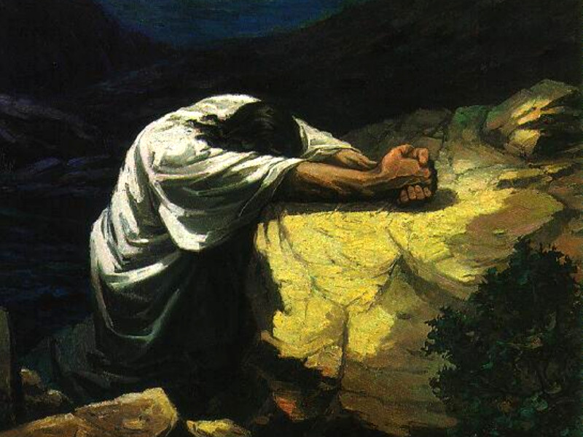
Rule 1: All Available Data
“Both in public and private worship, it is our privilege to bow on our knees before the Lord when we offer our petitions to Him” (GW 178).

Slide 30
“There is no time or place in which it is inappropriate to offer up a petition to God. . . . In the crowds of the street, in the midst of a business engagement, we may send up a petition to God. . . . We should have the door of the heart open continually and our invitation going up that Jesus may come and abide as a heavenly guest in the soul” (SC 99).
(Continues to slide 31)

Slide 31
“We may commune with God in our hearts. . . . When engaged in our daily labor, we may breathe out our heart’s desire, inaudible to any human ear. . . ”
(GW 258).

Slide 32
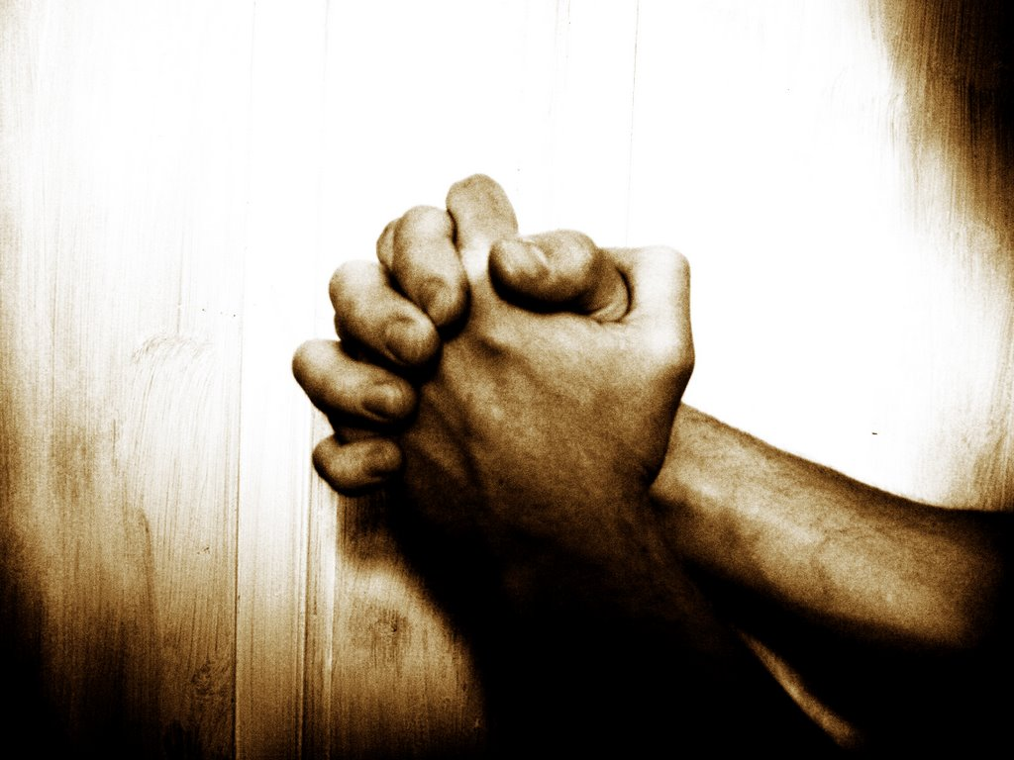
“We must pray constantly, with a humble mind and a meek and lowly spirit. We need not wait for an opportunity to kneel before God. We can pray and talk with the Lord wherever we may be.” (Letter 342, 1906, in 3 SM 266)

Slide 33
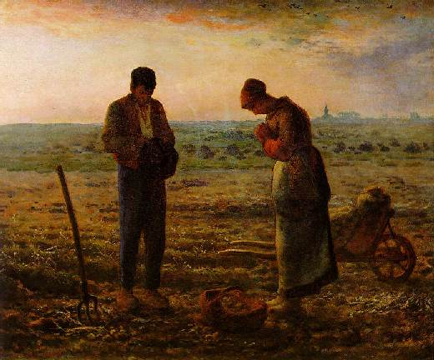
“You cannot always be on your knees in prayer, but your silent petitions may constantly ascend to God for strength and guidance.” (Special Testimonies, Series B, No. 15, pp. 11-15, June 3, 1907, in CH 362)

Slide 34
“It is not always necessary to bow upon your knees in order to pray.” (MH 510, 511)

Slide 35
Biblical Practice Varied
1. Prayer while standing: Nehemiah 9:4-5; Luke 18:11,13.
Solomon knelt for prayer of confession:
1 Kings 8:54.
David sat before the Lord in prayer: 2 Samuel 7:18; Exodus 17:11-12.
David prayed lying on his bed: Psalms 6:6-9; 63:6.

Slide 36
Historical Context: Battle Creek Tabernacle
A growing carelessness in Battle Creek Tabernacle and College
A sense that the individual praying had an attitude of self-sufficiency and self-importance.
First published in 1897, when Ellen White felt the whole church needed a renewed sense of reverence and dependence on God (2SM 311-313).

Slide 37
Historical Context: Ellen White’s Practice Varied
1. Once in Europe, when room was overcrowded, she instructed the people to remain seated for the prayer. Diary, Feb. 20, 1887, cited in 1SM 147; 3SM 267, 268.
2. On at least three occasions, she stood, and invited the people to stand with her:
Mar. 7, 1908, at Oakland, CA (3SM 268, 269).
Feb. 8, 1909, also at Oakland, (3SM 269).
May 18, 1909, at GC Session in Takoma Park, MD (3SM 269, 270).

Slide 38
Historical Context: Ellen White’s Practice Varied
4. D. E. Robinson, one of EGW’s secretaries (1902-1915), wrote on Mar. 4, 1934, “I have been present repeatedly at camp meetings and General Conference Sessions in which Sister White herself has offered prayer with the congregation standing, and she herself standing” (3SM 267, footnote).

Slide 39
Historical Context: Ellen White’s Practice Varied
Arthur White reported that “She was not known to kneel for the benediction at the close of services she attended. The earnest counsel on kneeling would seem to have its principal application in the worship services in the house of God and private devotions at home. In public ministry there were times when she stood for prayer” (3SM 270, footnote).

Slide 40
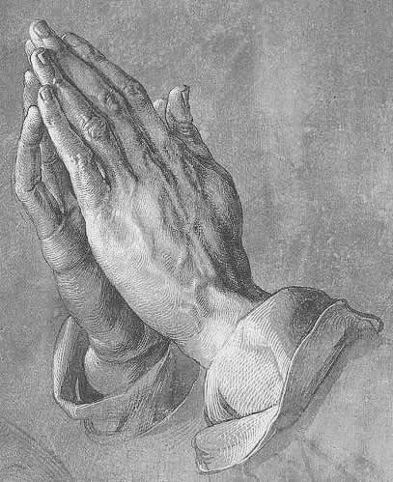
Principles on Posture in Prayer
1. Reverence for God: “There should be an intelligent knowledge of how to come to God in reverence and godly fear with devotional love. There is a growing lack of reverence for our Maker, a growing disregard of His greatness and His majesty.” (Ms 84b, 1897, cited in 2SM 312)

Slide 41
Principles on Posture in Prayer
2. Dependence upon God: “Both in public and private worship it is our duty to bow down upon our knees before God when we offer our petitions to Him. This act shows our dependence upon God.” (2SM 312)

Slide 42
Attitude is essential, posture is not
In 1892 in Australia, EGW was so crippled by inflammatory rheumatism that she had to be carried up the stairway into the meeting hall. “I was not able to bow my knees in opening prayer or when I entered the desk [pulpit] as I usually do, but the form is not the essential part. My heart went up to God in earnest prayer and He did help me and I believe gave me a decided message for the people assembled.” (Ms 29, 1892, emphasis supplied)

Slide 43
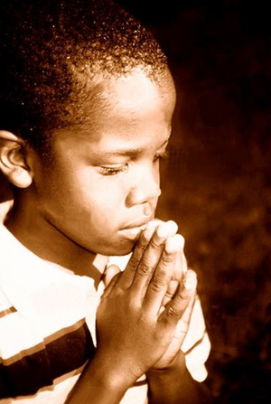
Conclusions on Posture in Prayer
1. Kneeling for prayer tends to increase our sense of reverence and dependence on God. So kneeling is “always” “proper” (2 SM 311) and should be used frequently.
2. But because posture is an aid to prayer, not the essence of prayer, “It is not always necessary to bow upon your knees.” (MH 510-511)

Slide 44
Conclusions on Posture in Prayer, cont.
3. Biblical admonitions to “pray without ceasing” underline the fact that if our attitude is right, there’s no posture that is inappropriate for prayer when circumstances demand it (1 Thes. 5:17; 1 Sam. 12:23; Acts 12:5; Rom. 1:9; 1 Thes 1:3; 2:13; 2 Tim. 1:3).
4. Ellen White, 2SM 311-316, emphasizes importance of kneeling; 3SM 266-270 explains that other postures are also appropriate.

Slide 45
Case 3: When Should Children Start School?
1872, “Proper Education”
“Parents should be the only teachers of their children until they have reached eight or ten years of age. . . . The only schoolroom for children from eight to ten years of age should be in the open air amid the opening flowers and nature’s beautiful scenery”
(3T 137).

Slide 46
Empirical Vindication of this Counsel
Physical development of the eyes is not complete until 8 or 10 years of age.
Psychological development of longer attention span.
Students home-schooled in early years consistently achieve higher than similar children who began school early (Raymond Moore, Better Late than Early).

Slide 47
Jan. 14, 1904, St. Helena, California Church School Board Meeting
Question: Did Ellen White intend her words as a prohibition against any organized schooling for children under the age of 8?
Transcript of the discussion published in 3SM 214-216.

Slide 48
Basis of the Discussion
“There is a principle underlying every precept.” W. C. White (3SM 221:3; see also 222, 224).

Slide 49
Principles that Underlay Ellen White’s 1872 Counsel
1. A child’s mother is first and best teacher.
2. In 1872, there were no SDA schools. Children needed to be taught at home until they were spiritually strong enough to “not be led astray [by] the wickedness carried on in the common [public] schools” (3SM 217).

Slide 50
Other Principles She Emphasized in 1904
1. When parents cannot or do not teach their children at home, it is better for them to be in school at an early age, then wandering the streets without training or restraint (3SM 217:3; 220:3).
2. Some children are mentally, physically, and emotionally ready for school at an earlier age than others (3SM 219:1).
3. If parents neglect their responsibilities, the church has a responsibility to come to the aid of the children (3SM 219-220, 225).

Slide 51
Ellen White’s Trenchant Comment in this Meeting
“God want us all to have common sense, and He wants us to reason from common sense. Circumstances alter conditions. Circumstances change the relation of things” (3SM 217).

Slide 52
When the Ideal is not immediately possible
Principles are often stated in terms of an “ideal,” but Ellen White herself recognized that when the “ideal” is not possible in a given set of circumstances, we should choose the best course available to us in that situation.

Slide 53
Example of coping with less than ideal ( Letter 51, 1905, to Sr. Anderson in West Australia)
Circumstances: School-age children, no church school, and a non-Christian husband.
Options Ellen White suggested:
1. “Teach . . . your own children and . . . others.”
2. Start a church school.
3. Public school. “Where it can possibly be avoided, children ought not to be sent to the public school; for they are in danger of learning much evil. But your children would be far better in attending school than to be under the influence that pervades your home.”

Slide 54
Case #4: Vegetarianism vs. Flesh Diet
1. Ellen White was a 17-year-old Sunday-keeping pork-eater when she received her first vision, in December 1844.
2. She did not learn about the Sabbath until almost 2 1/2 years later, April 3, 1847 (EW 32).
3. She did not learn about vegetarianism or discard the use of pork until almost 20 years later, June 5/6, 1863 (CD 481).

Slide 55
Three Categories of Exceptions
1. Problems in travel
2. Therapeutic use in illness
3. Transition periods between cooks
Source: Roger W. Coon, Ellen G. White and Vegetarianism: Did She Practice What She Preached? (Pacific Press, 1986), 30 pages.

Slide 56
Yet she always claimed to have followed the “principles” of health reform

Slide 57
1870: “I have not changed my course a particle since I adopted the health reform. I have not taken one step back since the light from heaven upon this subject first shone upon my pathway. . . . I left off these things from principle. I took my stand on health reform from principle. And since that time, brethren, you have not heard me advance an extreme view of health reform that I had to take back. I have advanced nothing but what I stand to today” (2T 371, 472, cited in CD 483, 484 #24).

Slide 58
1897: “I present these matters before the people, dwelling upon general principles” (Ms 29, 1897, cited in CD 493, #24).

Slide 59
1904: “At the age of 76, she reported she was experiencing better health than ‘I had in my younger days;’ and she attributed this improvement in health to following ‘the principles of health reform’”
(Ms 50, 1904, cited in CD 482, 33).

Slide 60
1909: “It is reported by some that I have not lived up to the principles of health reform, as I have advocated them with my pen; but I can say that I have been a faithful health reformer. Those who have been members of my family know that this is true” (9T 158, 159).

Slide 61
Is Vegetarianism a “Principle”?
“Principle” is used in a variety of ways.
When “principle” is defined as we are using it here, as an unchanging norm that applies to all people for all time and in all places, then vegetarianism is not itself a principle, but an application of health principles.

Slide 62
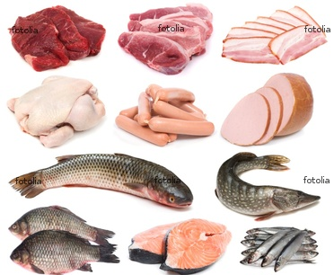
If vegetarianism were a principle, it would have been wrong for God’s people in Bible times, to have eaten meat and fish.

Slide 63
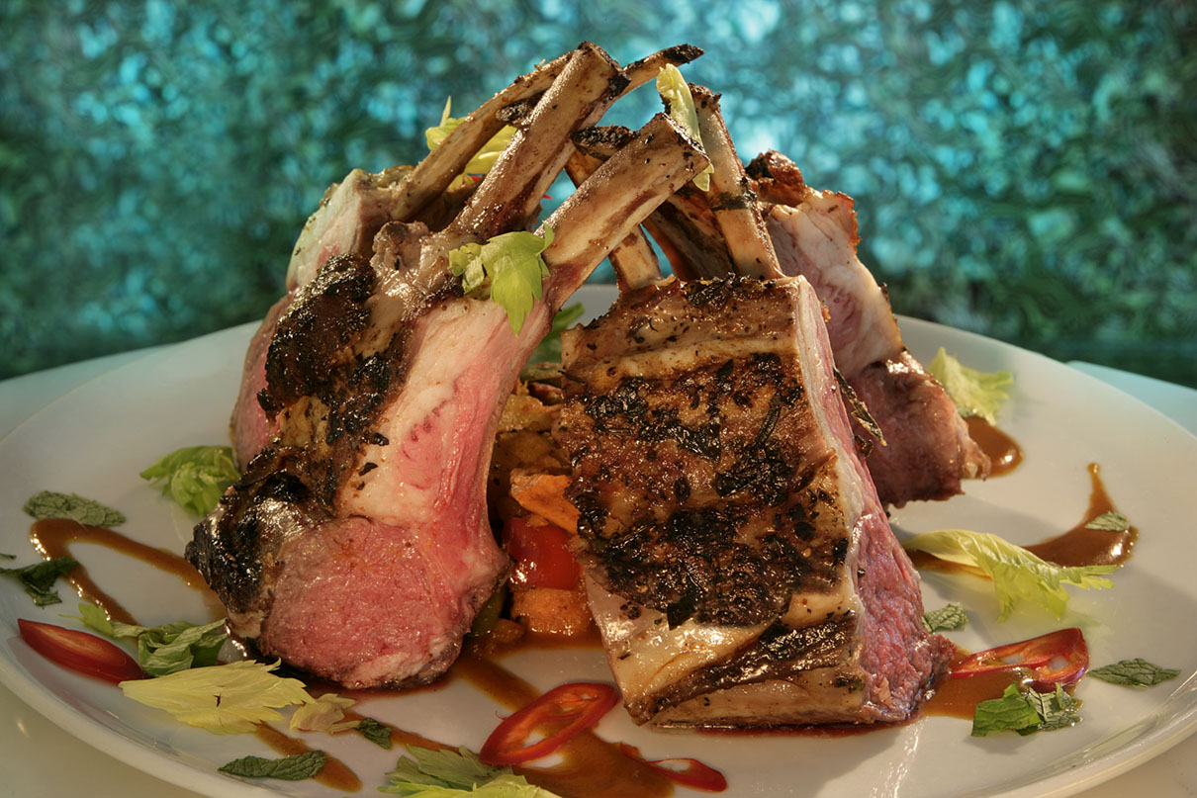
Biblical Examples
1. Abraham fed veal to Christ and His two accompanying angels (Gen. 18:7,8).
2. Christ instructed Israel to eat roast Passover lamb on the night of the Exodus, and annually thereafter (Ex. 12:1-14).
3. Christ Himself not only ate the Passover lamb, but often ate fish from Galilee--even after His resurrection (John 21:9-10).

Slide 64
So Vegetarianism must be an application based on several principles:
1. The human body is the temple of the Holy Spirit (1 Cor. 6:19).
2. The physical brain is the only channel through which God can communicate to us.
3. Whatever lessens our physical health, also lessens our mental ability to receive communications from God.

Slide 65
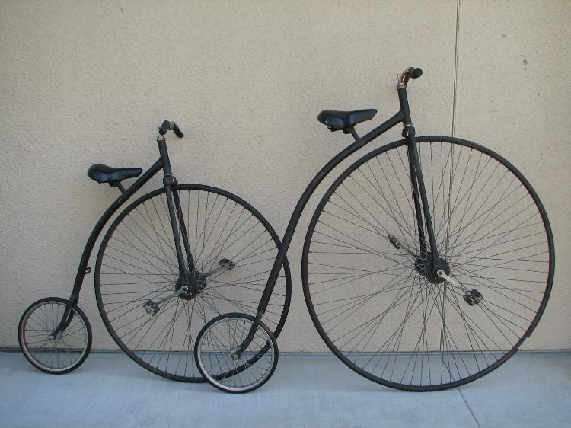
Case #5: The Bicycle Testimony

Slide 66
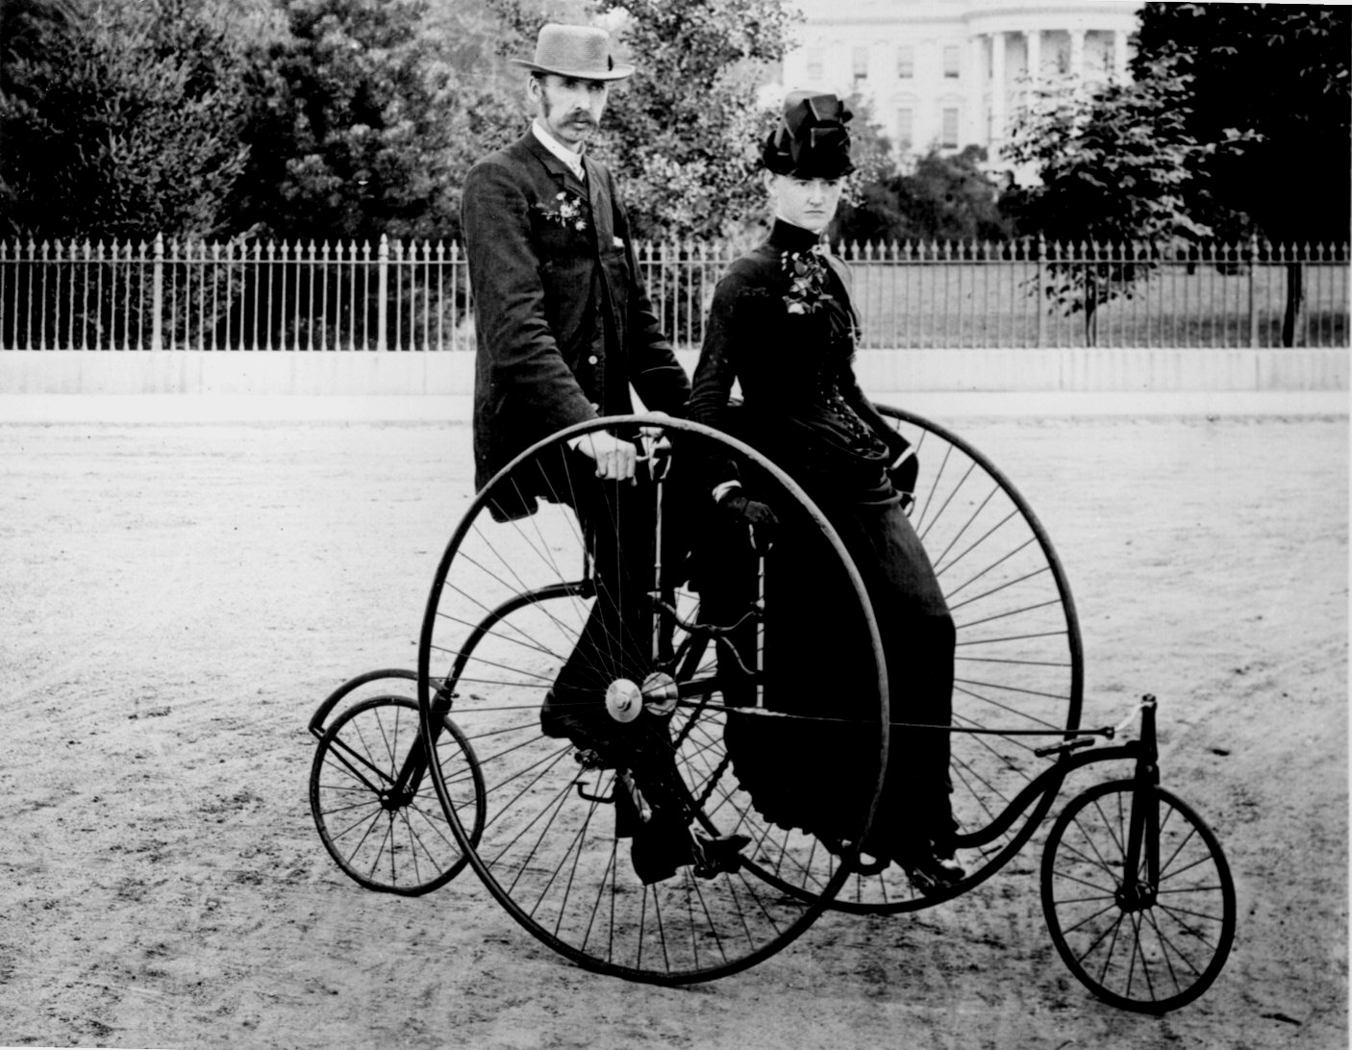
Historical Context
“The bicycle began as a rich man’s toy. . . . The best early bicycles cost $150, an investment comparable to the cost of an automobile today. . . . Every member of the family wanted a ‘wheel,’ and entire family savings often were used up in supplying the demand” (Frank Tripp, “When All the World Went Wheeling,” The Reader’s Digest, December, 1951, pp. 121-123).

Slide 67
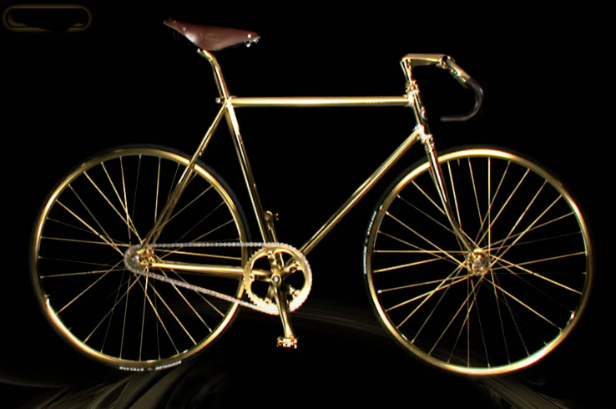
2010 =
= 1894

Slide 68
1894 Vision
“My Guide…said, ‘follow me.’…
There seemed to be a bicycle craze….
Satan works with intensity of purpose to induce our people to invest their time and money in gratifying supposed wants. This is a species of idolatry....
Some…were striving for the mastery, each trying to excel the other in the swift running of their bicycles” (8T 50-52).

Slide 69
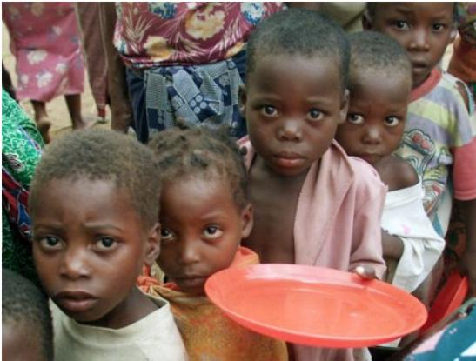
Principles Involved
1. Stewardship: “Money was spent to gratify an enthusiasm that might better, far better, have been invested in building houses of worship where they are greatly needed. . . . The example will be followed . . . while hundreds are starving for bread” (8T 51).
?

Slide 70
Principles Involved
2. Witness: “My brothers and sisters in Battle Creek, what kind of witness are you bearing to an unbelieving world? . . . Your practice contradicts your profession” (8T 51).

Slide 71
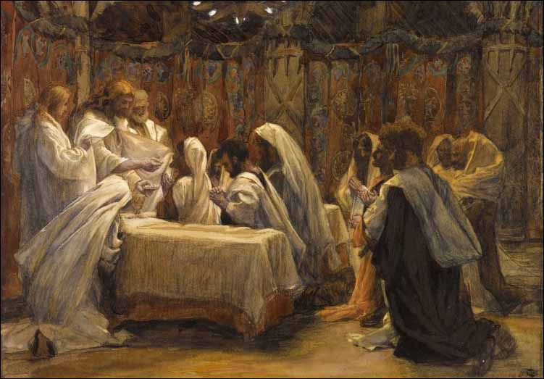
Principles Involved
3. Competition and Rivalry: “There was a spirit of strife and contention among them as to which should be the greatest…. Said my guide: ‘These things are an offense to God. Both near and afar off souls are perishing for the bread of life and the water of salvation’” (8T 52).

Slide 72
Principles Involved
4. Radical discipleship: “Let nothing, however dear, however loved, absorb your mind and affections, diverting you from the study of God’s word or from earnest prayer. Watch unto prayer. Live your own requests. Co-operate with God by working in harmony with Him. Expel from the soul-temple everything that assumes the form of an idol” (8T 53).

Slide 73
Changing Circumstances
1. In a few years, the bicycle became one of the most economical and practical means of personal transportation.
2. The use of inexpensive bicycles for practical purposes does not violate the principles.
3. The principles remain, however, and would apply to many other situations.

Slide 74
Case Study 6: Certain Aspects of Sabbath Keeping
1. No cooking during Sabbath hours (6T 355, 357).
2. Baths should be taken before sunset on Friday (6T 355).
3. “Shaving” should also be done before “the beginning of the Sabbath” (ST, May 25, 1882, p. 7).

Slide 75
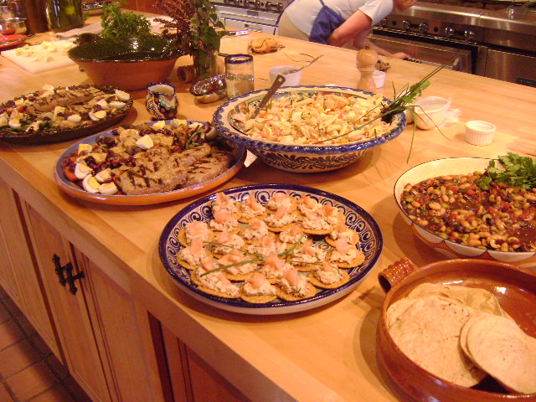
Cooking on the Sabbath: The Counsels
1. “Cooking upon the Sabbath should be avoided” (6T 357:3).
2. “On Friday let the preparation for the Sabbath be completed. See that . . . all the cooking is done” (6T 355:3).

Slide 76
Cooking on the Sabbath The Counsels
3. “While cooking upon the Sabbath should be avoided, it is not necessary to eat cold food. In cold weather let the food prepared the day before be heated.”
4. “Let the meals, though simple, be palatable and attractive. Provide something that will be regarded as a treat” (6T 357).

Slide 77
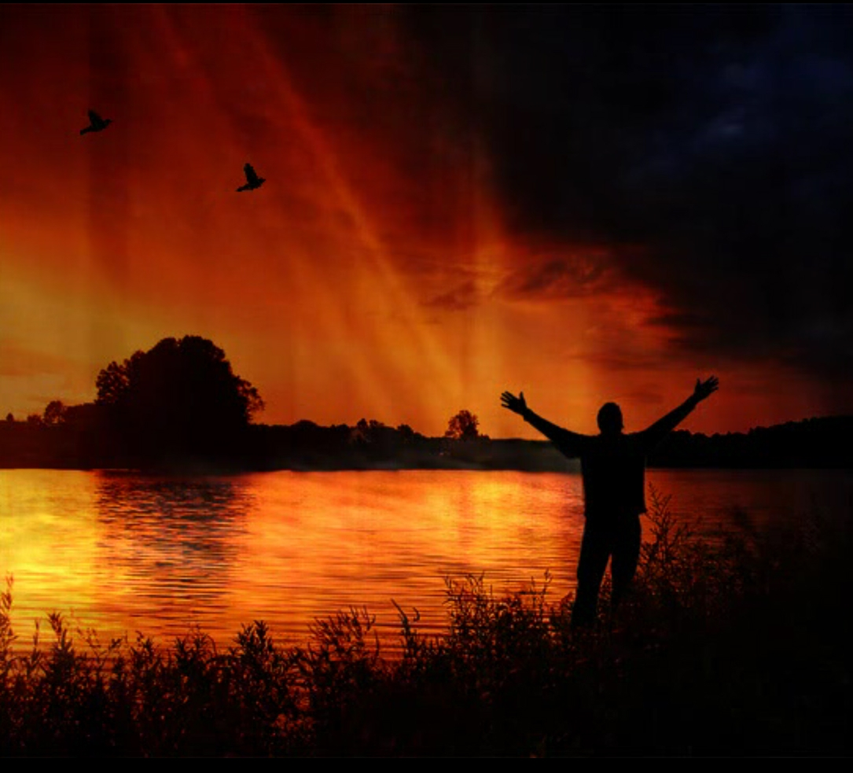
Principles
1. All unnecessary “work” on Sabbath is to be avoided.
2. Preparation. The joy of the Sabbath and its distinctiveness from weekdays are both enhanced by preparation (6T 354).

Slide 78
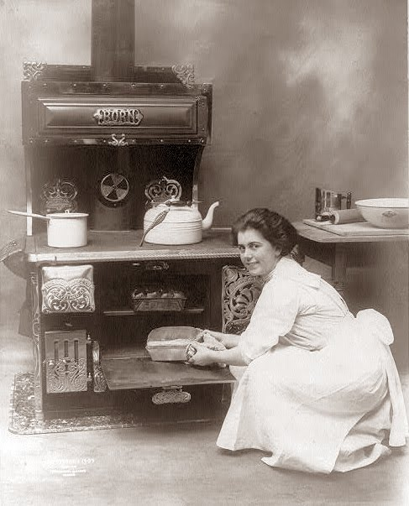
Historical Context
1. In 1900, the cooking was done on wood stoves. Even today, cooking a meal from scratch involves time and work.
2. Work was not to be done on Sabbath.

Slide 79
Application Today
1. Self-timing ovens can cook Sabbath dinner while the cook is worshiping in church.
2. Microwave ovens and pre-prepared foods can reduce the work of cooking to the permitted level of “warming up” food already prepared.
3. Preparation still increases “delight” in the Sabbath, but some aspects of cooking are not the “work” they used to be.

Slide 80
Sabbath Baths The Counsel
“On Friday let the preparation for the Sabbath be completed. See that all clothing is in readiness and that all the cooking is done. Let the boots be blacked and baths taken”
(6T 355:3).

Slide 81
Principles
1. The “work” of bathing was to be done before the Sabbath began.
2. Preparation: Sabbath keepers were to greet the holy day with clean bodies.

Slide 82
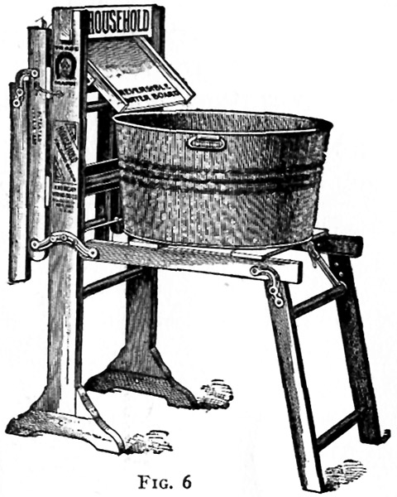
Sabbath Baths Historical Context
1. No automatic hot-water heaters. Water had to be pumped, carried, and heated.
2. Homes of common people had no bathrooms. Baths were typically taken in a portable tub on the kitchen floor. Provision for privacy inevitably disrupted the routine of the rest of the family.
3. Most took only one bath per week.

Slide 83
Application Today
1. In developed countries, most houses have running water, automatic hot-water heaters, and showers.
2. A shower can be completed in five minutes, more or less.

Slide 84
Application Today
3. Most are accustomed to taking a shower daily, just as they clean their teeth daily.
4. A Friday evening bath may still be needed.
5. But if one wishes to freshen up on Sabbath morning with a quick shower, that would not necessarily be a violation of the counsels given against Sabbath bathing.

Slide 85
Application Today
One’s own conscience before God must always be sacredly guarded.
Do not violate your conscience just because someone else thinks a particular activity is OK.

Slide 86
Shaving on the Sabbath: The Counsel
“Many carelessly put off the blackening of their boots, and shaving, until after the beginning of the Sabbath. This should not be. If any neglect to do such work on a working day, they should have enough respect for God’s holy time to let their beards remain unshaven, their boots rough and brown, until the Sabbath is past. This might help their memory, and make them more careful to do their own work on the six working days” (ST, May 25, 1882).

Slide 87
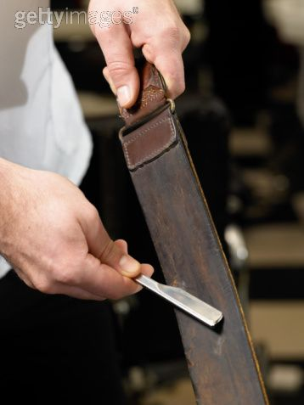
Historical Context (1882)
1. Most men wore full beards and did not shave daily.
2. Shaving involved heating water, sharpening the razor on a leather strap, brushing soap on the face, and scraping it off.

Slide 88
Principles
1. No work on the Sabbath
2. Preparation before Sabbath not only helps avoid Sabbath work, but enhances our anticipation and enjoyment of the Sabbath hours.

Slide 89
Application Today
1. The social context is different.
2. A weekly beard trim could be done before Sabbath.
3. But for a normally clean-shaven man to appear on Sabbath with a 16-hour growth of whiskers could be similar to arriving with uncombed hair.
4. With an electric razor, or even a safety razor and hot running water, shaving is not the “work” it was 120 years ago.

Slide 90
Application Today
5. Conclusion:
If a man shaves daily, it is a matter of personal conscience whether he chooses to do so on Sabbath.
If a pastor were to come to the Sabbath worship of God in a “grubby” condition, that would contradict other counsels about honoring God’s house and His holy day by appropriate dress and grooming.
Yet I have to recognize that I am speaking from a certain cultural bias, and not all will agree.

Slide 91
Summary, Principles and Applications
1. Principles are timeless and universal.
2. Particulars are applications of principle(s) to a particular concrete situation in time and space.
3. Without specific concrete application, a principle remains abstract and theoretical. To become real in human life, principles have to be articulated in terms of specific behavior precepts.

Slide 92
Summary, continued
4. The dynamic that links principles and particulars is that of incarnation. Love without deeds is not real love (James 2:16). Faith without action is dead (James 2:17). Likewise, reverence, modesty, stewardship, and Sabbath keeping are all principles that unless incarnated in behavior, remain empty of practical meaning and invisible to the world. Principles become visible only when actualized in a given situation.

Slide 93
Summary, continued
5. Therefore, particular applications given by inspiration are as binding within the context in which they are given as are the inspired principles they represent.
6. It is a fallacy to believe that because precepts are subordinate to principles, that they are less obligatory, and can be ignored with impunity. In the situation for which it was given, a particular application is the incarnation of the principle, to be obeyed as a representation of the principle.

Slide 94
Summary
7. Because principles are timeless and universal, we can never say that a principle “no longer applies.” When a particular application no longer expresses the principle as well as it originally did, the principle still applies, and responsible obedience to the will of God obligates us to discover how that principle applies to the current situation.

Slide 95
Conclusion
Every disciple has an double obligation to the world:
to display God’s principles through his/her lifestyle, and
to explain those principles to whoever asks Why you live this way?

Slide 96
“Let your light so shine before men, that they may see your good works and glorify your Father in heaven.” Matthew 5:16
“. . . and be ready always to give an answer to everyone who asks you a reason of the hope that is in you.” 1 Peter 3:15

Slide 97
Priesthood of Believers
1. Counsel with brothers and sisters in the Lord. “In the multitude of counselors there is safety” (Prov. 11:14).
“As iron sharpens iron, so one man sharpens another” (Prov. 27:17NIV).
2. Consult published sources, such as CD-ROM; 3-volume Index; Herbert Douglass, Messenger of the Lord, and many others.
3. Contact the Ellen G. White Estate.
World Wide Web: <http://www.WhiteEstate.org>
Telephones: 301-680-6545, 6552

Slide 98
Acknowledgements
This lecture adapted by permission from Roger W. Coon, “Hermeneutics: Jemison’s Third Rule,” April 11, 1995.

